Slide 1
Land Use Strategy Development - Update
Nuleaf
Frank Wigley
31st October 2023

Slide 2
End State and land use Update
Progress – Site License Companies
Magnox.
  Applications and permissions for disposals at Winfrith and Traws 23/24
  High level assumptions generated for Berkerley and Chapelcross. Sizewell, Dungeness, Hinkley underway.
  Work underway to establish process of meaningful stakeholder engagement
  Building first draft of the strategic thread for reactor sites by close of FY
  Understanding what land needs to be used for what and when
Sellafield
  High Level technical assumptions for original components.
  Work underway for Groundwater and contaminated land components
  Work underway to establish process of meaningful stakeholder engagement
  Understanding what land is needed for what and when
Dounreay
  Understanding implications and robustness of end state assumptions
  Particular work on LLW pits

Slide 3
End State and Land use Update
Progress NDA
International peer review. IAEA and NEA working groups
Town and country planning
Communications.
Understanding the “So what”
  Managing strategic interfaces between end state, decommissioning and land use (both interim and future)
  Change control
Masterplanning

Slide 4
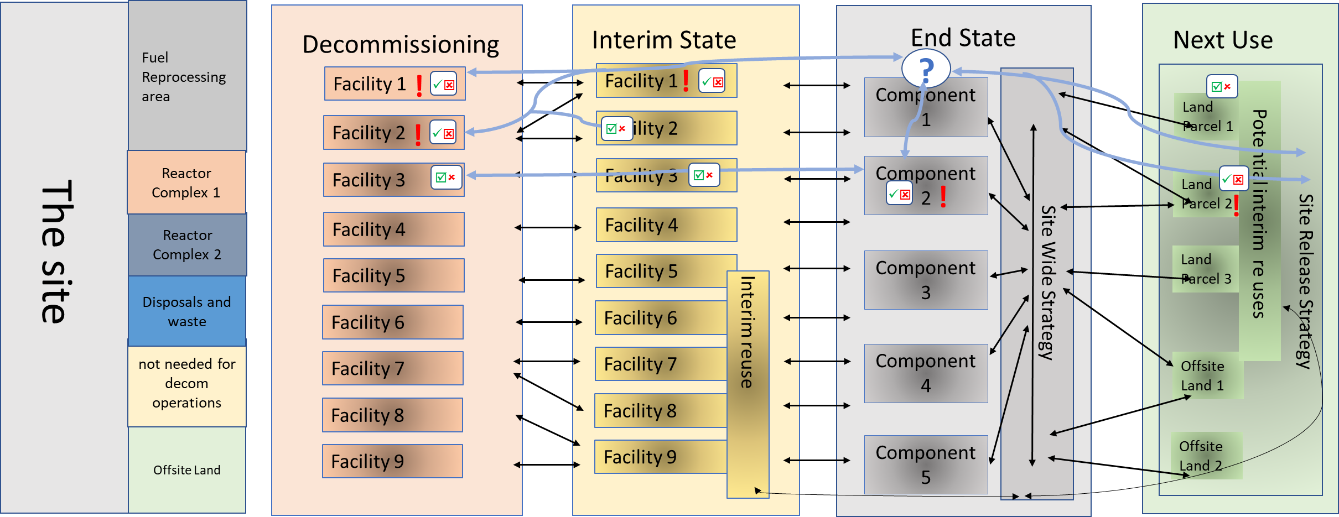
Change Control through strategic thread
Managing Strategic Uncertainties, Confidence and Assumptions though long delivery times
What uncertainty is reasonable?
So what?
Does it matter?
Confidence of strategic assumptions
Tolerance thresholds
Uncertainty amplitude
Is it material
What other assumptions does this affect
Where do we need to focus work?
What level pf programme risk is acceptable
Planning for events and later intervention

Slide 5
Strategic thread in Strategy Management
Supplements Stage B papers;
Establishes high level strategic tolerances and key assumptions for geographical zones of the site and/or for feature types;
Provides an assessment of confidence in the resilience of each strategy
Provides a view of the potential impact on the delivery programme if that strategy assumption is inadequately conceived or executed;
Describes the maturity of the strategies e.g., how underpinned they are and what degree of endorsement they have;
Uses a RAG status for the parameters of “confidence”, “consequence”, “approved / remains relevant” and “implementation alignment” which can be viewed together as a heat map to provide an at‑a‑glance overview of strategic health;
Records the intended benefits, as well as opportunities and/or alternative outcomes of each of the strategies and, where appropriate, raises actions to consider the potential opportunities further;
Identifies inconsistencies between strategies and places actions which could ultimately result in changes being made to the Lifetime Plan;

Slide 6

SST Governance (Draft)
Key Performance Indicators
Board Governance of SST
Structured through its own development process
Develop
Review with Teams
Baseline
Sign Off
Review
SST/relevant strategies
- Board support backed by SOS and LTP
Data
(Current information)
Deliver improvements where necessary
Information, alignment, strategic direction, gaps
SST development – By Decommissioning and End State Strategy Teams with input from Central Strategy, Ops, Risk, Project Controls, as required
OFFICIAL

Slide 7
Logic Map
Common understanding, SST is fed back into the SOS and LTP
Drivers
Objectives
BENEFITS
Changes
Enabling
Assets
Lack of strategic integration & alignment between Decommissioning, Interim State, End State, and Land Use strategies
Implement a more effective strategic integration and alignment process between the decommissioning areas
Alignment and improved reliability of decommissioning delivery plans
to time & budget
Review strategy governance processes to see how SST fits within, is any change required?
Change management/ Knowledge management programme
Lack of a simple heat-map tool that provides snapshot of decommissioning “strategic health” (across the board)
Develop a Site Strategic Thread for each Site that can inform strategic and tactical decisions in the form of a snapshot
Alignment with local plans and other stakeholder expectations
Review decommissioning communication processes and tools to see how SST fits within
Current and forecast data: info and knowledge on Site decommissioning operations, people delivering work
It is not known how changes to individual Site decommissioning strategic assumptions impact on each other and the wider Group
Develop a plan for each Site that records and tracks remedial actions
System that highlights common challenges, gap areas, threats, and opportunities
Implement Live Site Strategic Thread and Artefact Planner for each Site, and Configuration control
Site decommissioning strategies such as Decomm., Interim State, End State, and Land Use
OFFICIAL

Slide 8
Components of SST
Implications on:
Waste management
Land use plans
Drivers
Objectives
KEY ATTRIBUTES
Gaps and clashes have been identified between Site decommissioning strategies
Establishes a standard framework and records key decommissioning assumptions of a Site, reflecting a clear vision
It must enable options such as making changes to missions to be assessed and integrated. It must become part of the Site’s capability and remain flexible.
Certain assets and land are becoming scarce, resources and their use needs to be planned better
Develop a Site Strategic Thread for each Site that can inform strategic and tactical decisions in the form of a snapshot
A comprehensive plan of action
It must be sufficiently detailed to provide confidence and direction to the Site and the NDA
An evolving, long-term planning document
It must set out the future, encompass external factors and be based on evidence based data to allow strategic & tactical planning and optioneering.
It is not known if existing decommissioning plans can be delivered within the planned timeframe and budget constraints or not
A framework within which a Site can develop or challenge its Thread
It must be supported with the required strategies, processes and policies to provide a framework for change
OFFICIAL

Slide 9
SST Content
Decision making
Supporting documents
Data
Strategies
Policies
Strategic Decisions
Site plans – 5-year or more
Land use plans, strategic buildings, transport assets, utility assets, site constraints & boundaries, permissions,
Waste (group categories, volume and location)
People, Active and non-active assets
Site Decommissioning Strategies
LA – Land Use
Site level programmes & cost schedules
Managing radioactive substances and nuclear decommissioning
Site Interim State Strategies
RAID Logs & Opportunity registers
Site End State Strategies
UK policy framework for managing radioactive substances and nuclear decommissioning
Site Land Use Strategies
Tactical Decisions
Detailed Site plans – within the next 5 years
Short(er) term land use, buildings use,
Detailed transport, utility assets
Site constraints & boundaries,
Waste (categories, volume, type of storage, location)
People
Integrated Waste Management Strategies/Integrated Waste Implementation Plans
LA – Waste Management
Detailed Programmes & cost schedules
Strategic Outcome Specifications
Corporate Strategies (SL)
OFFICIAL

