Slide 1
EIADR update
January 2024
Update to Nuleaf Radioactive Waste Planning Group

Slide 2
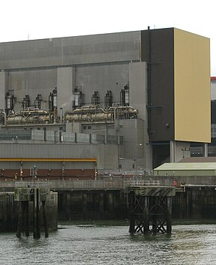
Background
EIADR is a mechanism whereby the ONR grant consent for a decommissioning project to commence.
The operator has to prepare an Environmental Statement (an EIA for the whole project).
EIADR was brought in following the EU’s EIA Directive, and links to the Aarhus Convention.
however…
EIAs as part of the planning process are still required throughout the project.

Slide 3
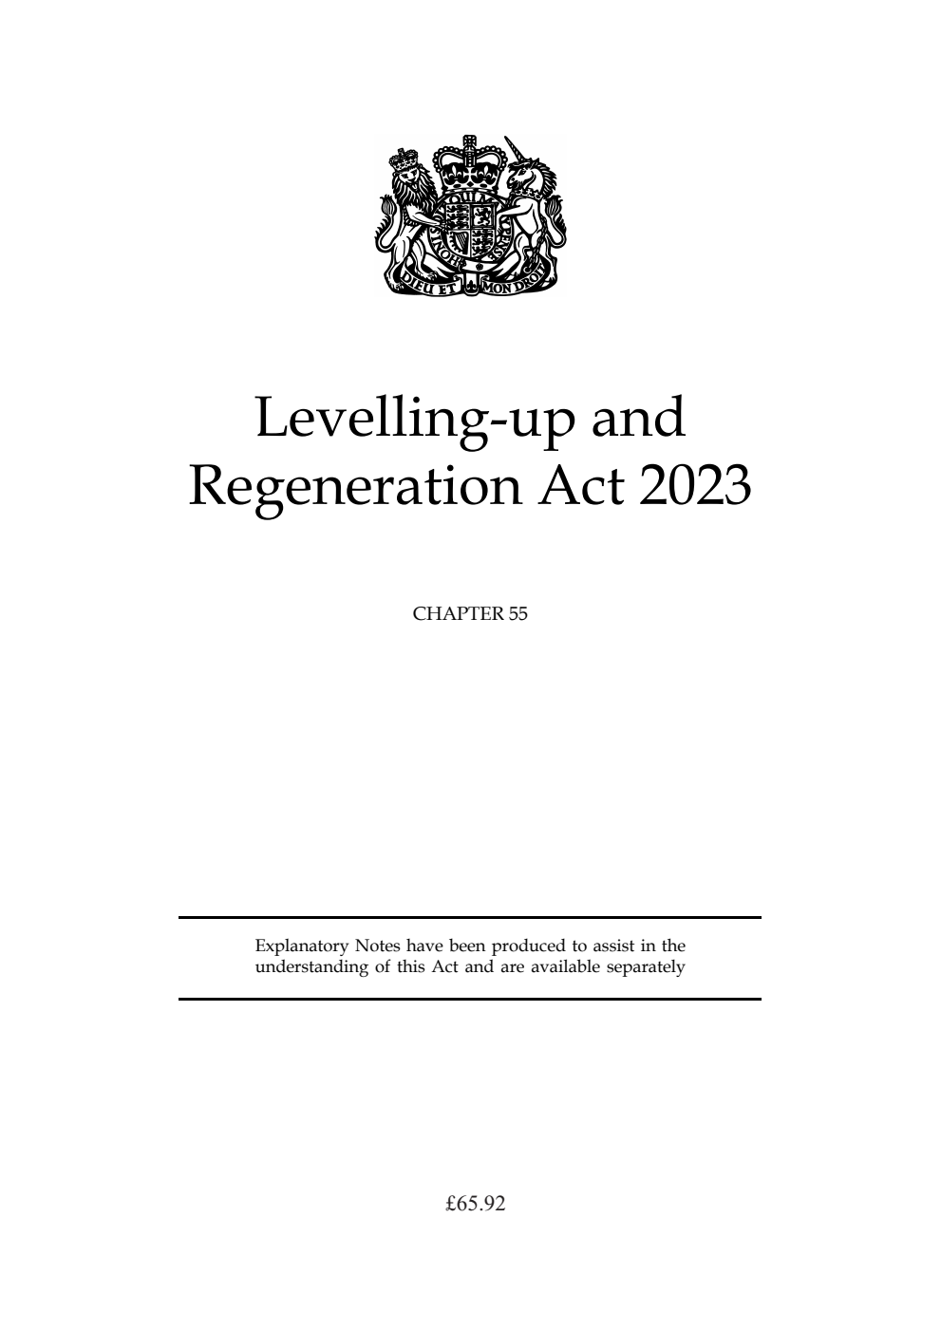
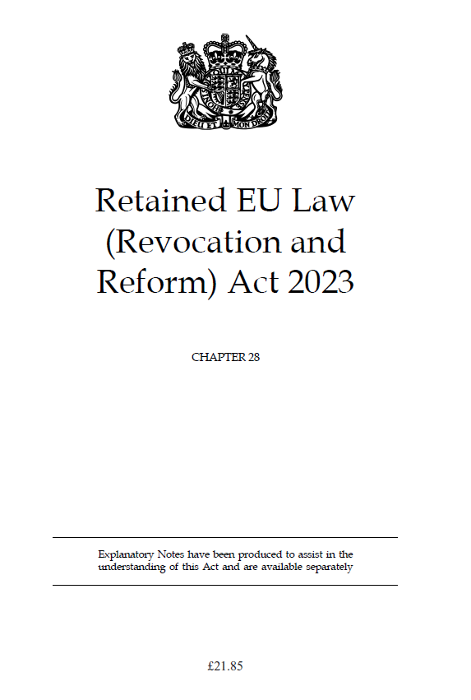
What’s changed?
Retained EU Law Review
Political desire to review, reform and revoke REUL across government.
2. Levelling Up Act and Environmental Outcomes Reports (EORs)
DLUHC are planning to change the EU-derived “likely significant effects” system to and outcomes-based approach
3. Proportionate Regulatory Control
BEIS (as was) proposals to end ONR’s regulation of nuclear sites in the final stages of decommissioning

Slide 4
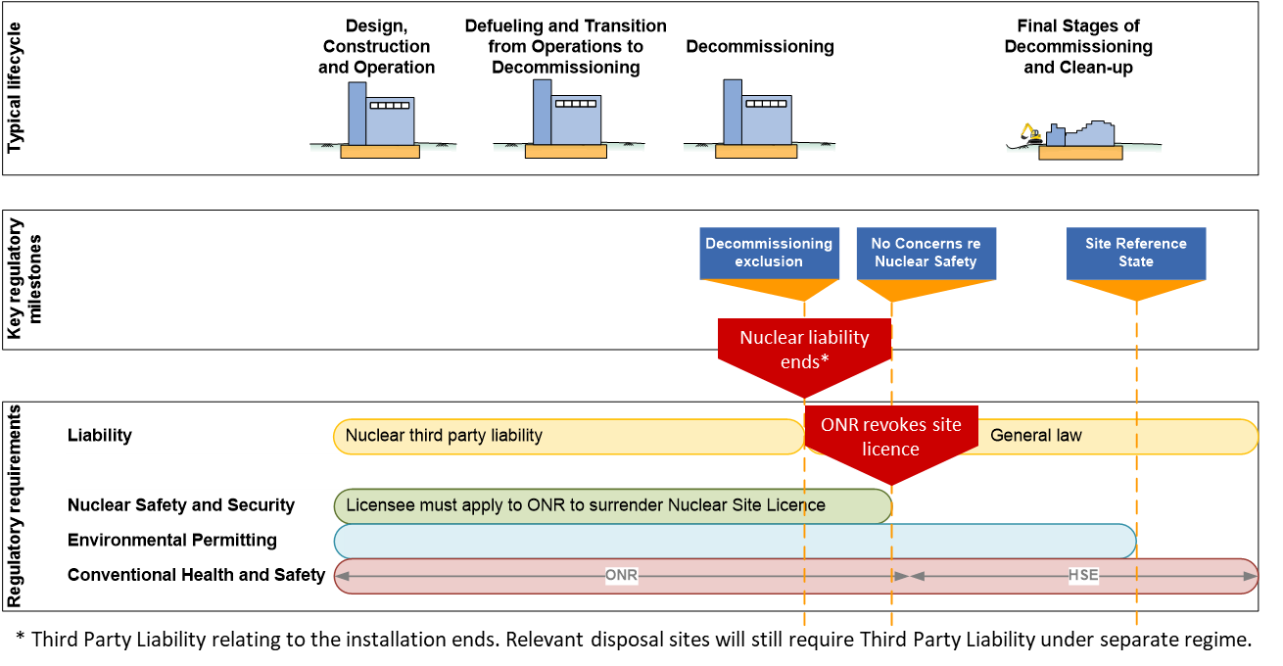
PRC regime

Slide 5
EOR system
Current suggested outcomes:
biodiversity
air quality
landscape and seascape
geodiversity, soil and sediment
noise and vibration
water
waste
cultural heritage and archaeology
Regime-specific outcomes can be added by secondary legislation
DLUHC-led, with x-WH collaboration.
Moves away from the EU-derived system of “likely significant effects” of the development, which is exhaustive, and more open to legal challenge.
The outcomes in the EOR system are linked to environmental objectives in the 25-year Environment Plan, linking national priorities to the local level.
Objectives would be assessed by a series of indicators set out in secondary legislation and guidance.
Unclear as yet if this system works for EIADR, which considers projects over a long time scale.

Slide 6
AGR + SWB timeline
Station | Type | Expected shutdown / defueled
Hunterston B | AGR | 2022 / 2025
Hinkley Point B | AGR | 2022 / 2025
Hartlepool | AGR | 2026 / 2029
Heysham 1 | AGR | 2026 / 2029
Dungeness B | AGR | 2028 / 2032
Heysham 2 | AGR | 2028 / 2032
Torness | AGR | 2028 / 2032
Sizewell B | PWR | 2035 / 2038

Slide 7
Previous Nuleaf feedback
Noted apparent duplication of effort between aspects of the planning process and EIADR – one particular example highlighted was for demolitions and the site restorations considerations there.
Unclear how ONR actually regulates EIADR and the Environmental Management Plans on an ongoing basis
Prevailing Nuleaf view that local authorities may lack the capability and capacity to take on EIADR regulation from ONR at the point of delicencing
Preferred option of those who responded: that EIADR end at the end of the licence and environmental impacts of the project are continued to be regulated under T&CP EIAs, where necessary

Slide 8
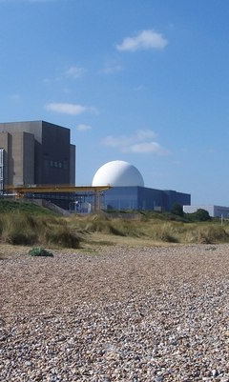
Questions for the RWPG
does your recommendation remain the same regarding what should happen at the point of delicencing?
Is there a way by EIADR could be made more useful to LAs and LPAs?

