Slide 1
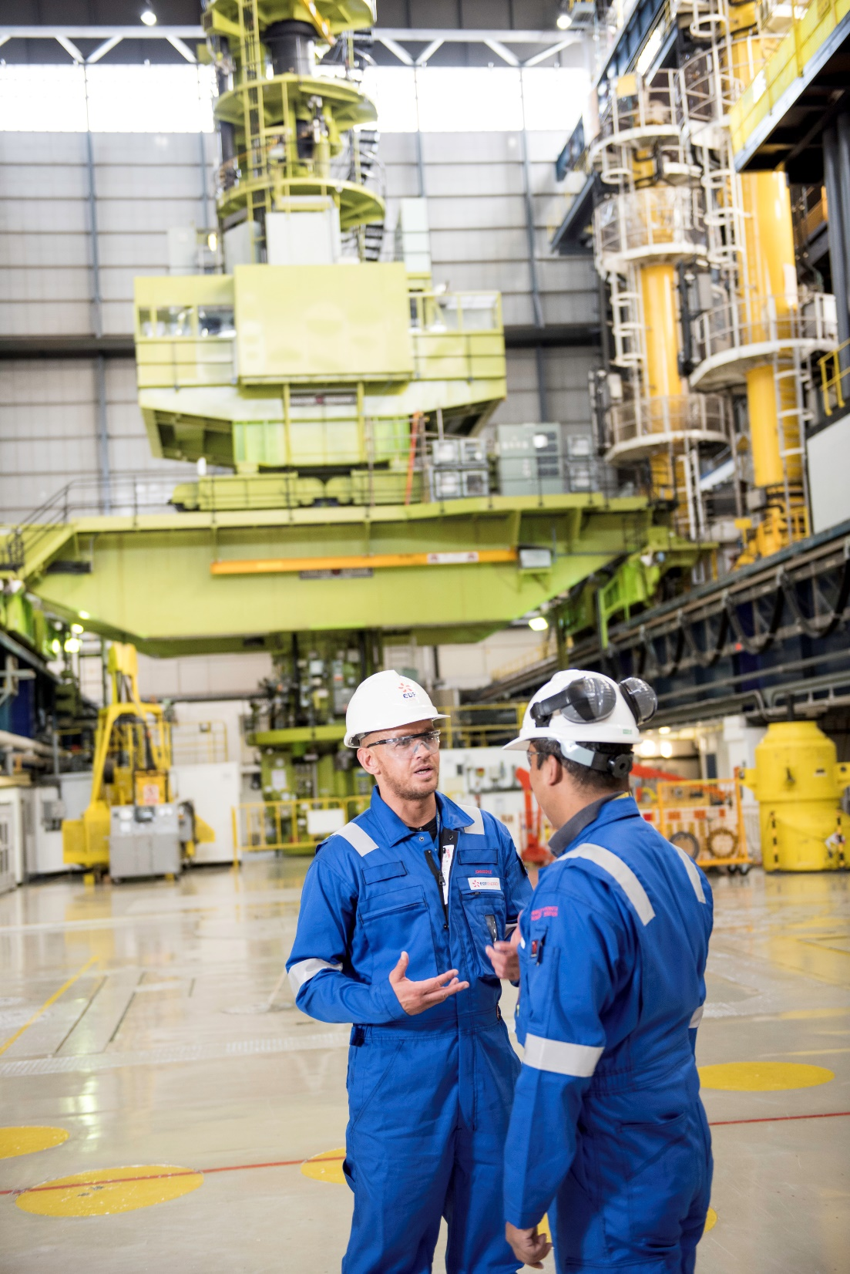

Joint Advanced Gas-cooled Reactor (AGR) sites transfer update
Nuleaf Steering Group
13 March 2024
Paul Morton, EDF
Andy Munro, NRS
Dale McQueen, NDA

Slide 2
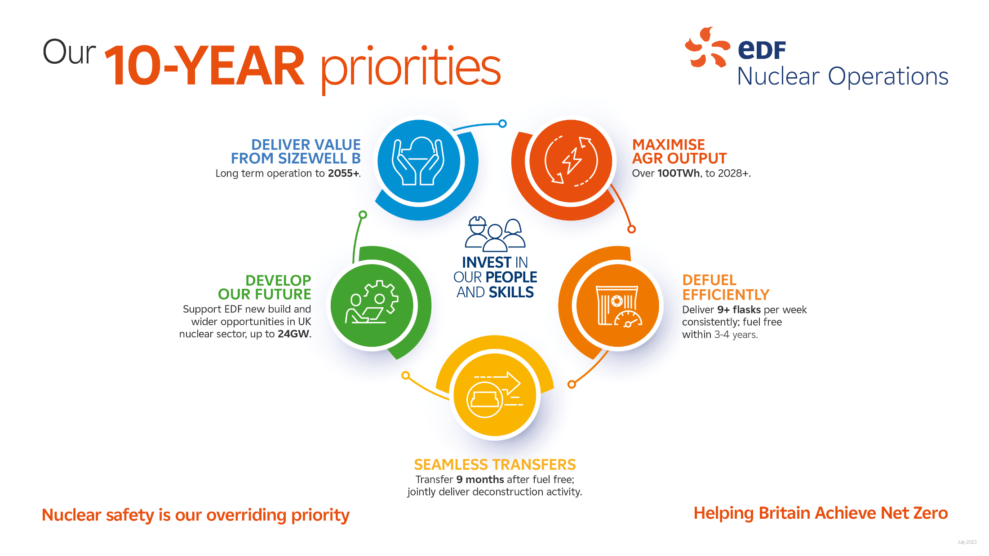

Slide 3

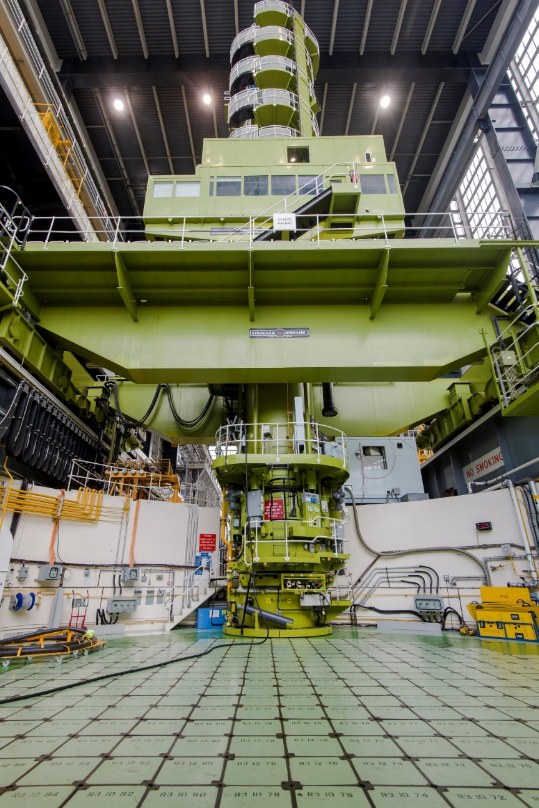
Defuel efficiently
  EDF is responsible for defueling, NRS will carry out long term decommissioning.
    First Hunterston B reactor defueled – Sept ‘23
    First Hinkley Point B reactor c. 70% defueled
    Active defueling started at Dungeness B
  Heysham 1 flask corridor upgrades completed to help defueling once offline. The same planned at Hartlepool and Dungeness.
  Expenditure on defueling has so far remained below forecasts. 2024 is a big year for flask movements.
.
Notes:
Paul
EDF is responsible for defueling the 14 AGR reactors (remember they are twin reactors, so 2 on each power station)
This is being managed under an agreement signed with Government in mid 2021
Excellent progress over 2023, with nearly 400 spent fuel flasks safely despatched to Sellafield for processing
We have a contract with UK Government that we are determined to deliver upon. We’re near the start of this journey but it’s going well and we’re learning lots along the way.
Forward focus:
Defuel HNB by mid 2025, HPB by end 2025, DNB in ~2028 and service the needs of generating sites
Deliver 9+ flasks per week, consistently and reliably. In 2024 we have a plan to despatch nearly 500 flasks to Sellafield
Collaborate with Sellafield and AGROP partners to get the best outcomes for tax payers
Prepare for defueling at generating AGRs – needs to continue despite ambition on generating lifetimes

Slide 4
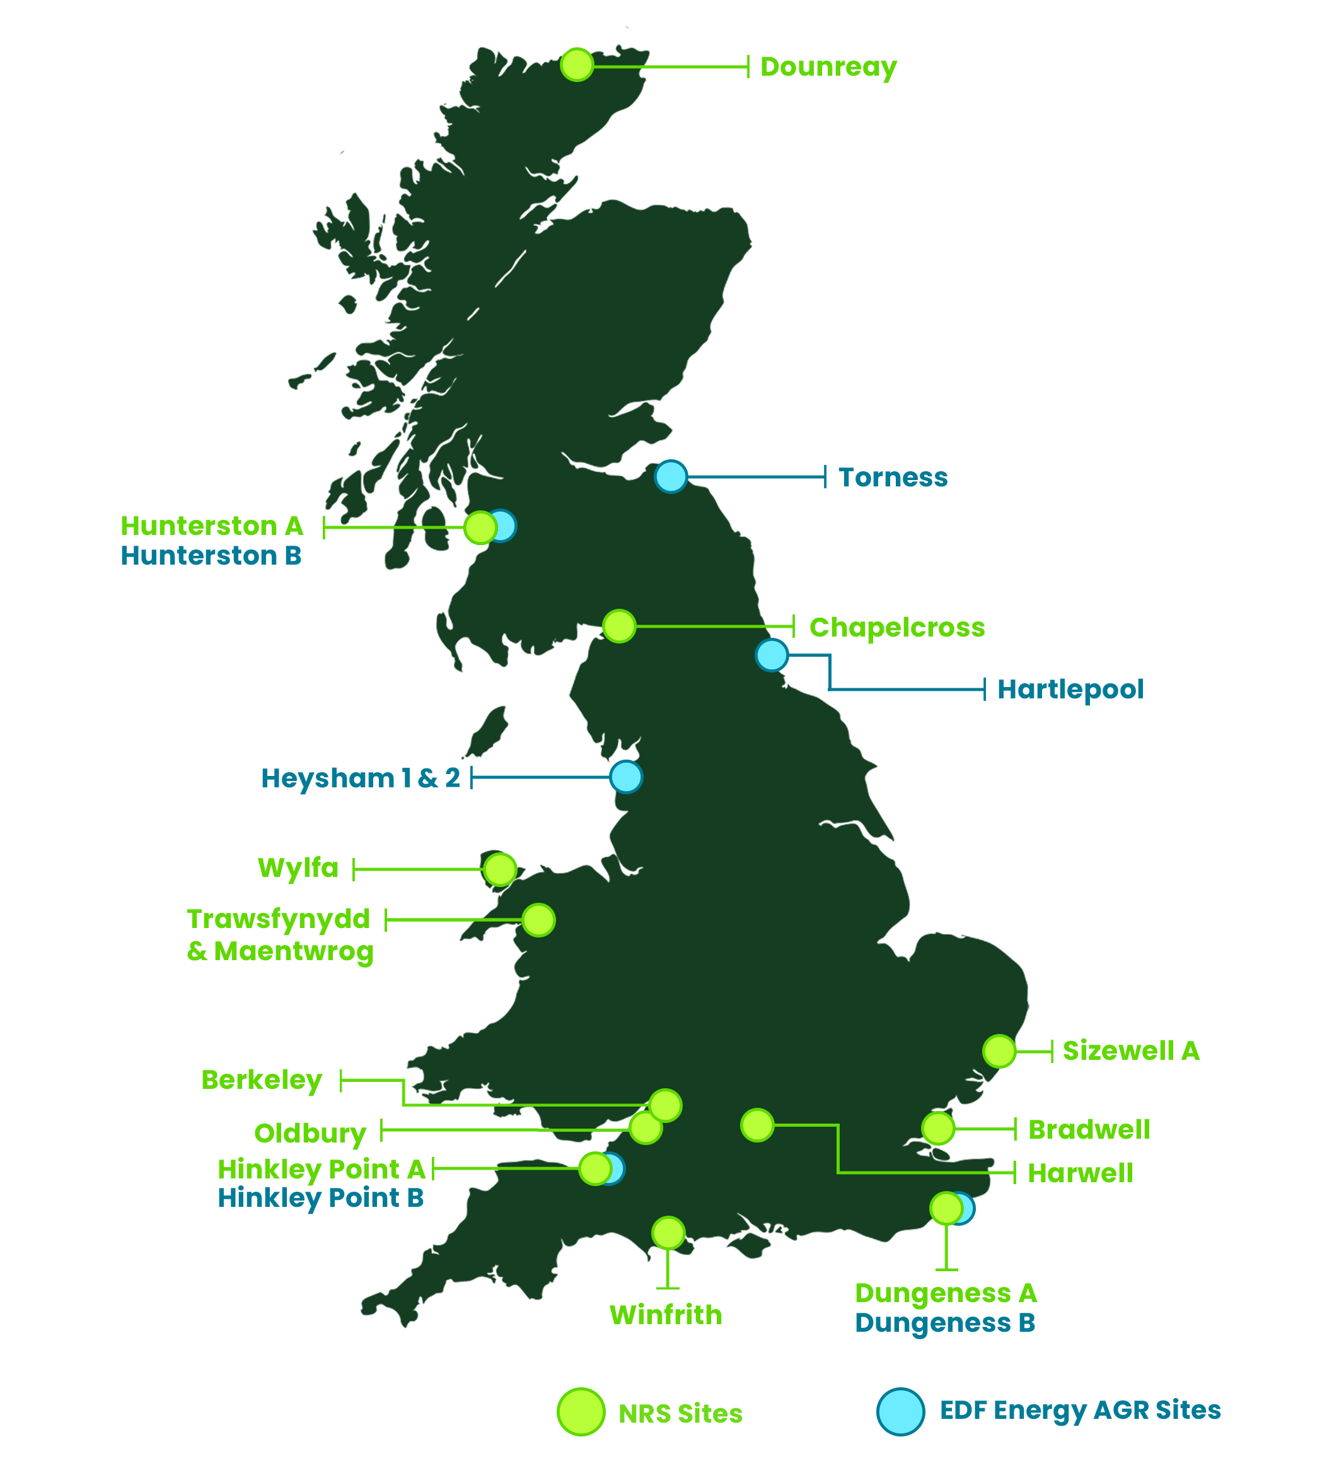

Our 10-year strategy
Deliver our existing commitments safely, securely and sustainably
Transform how we operate our business
Innovate across technology, systems thinking and the future potential of our sites
Grow to take on new missions in a careful and considered way.

Slide 5
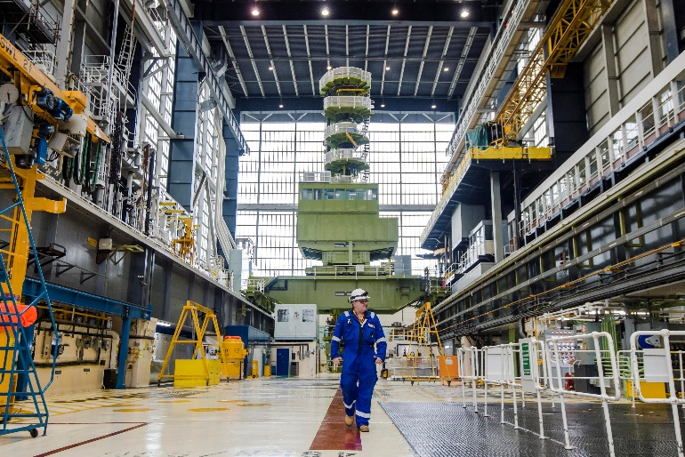
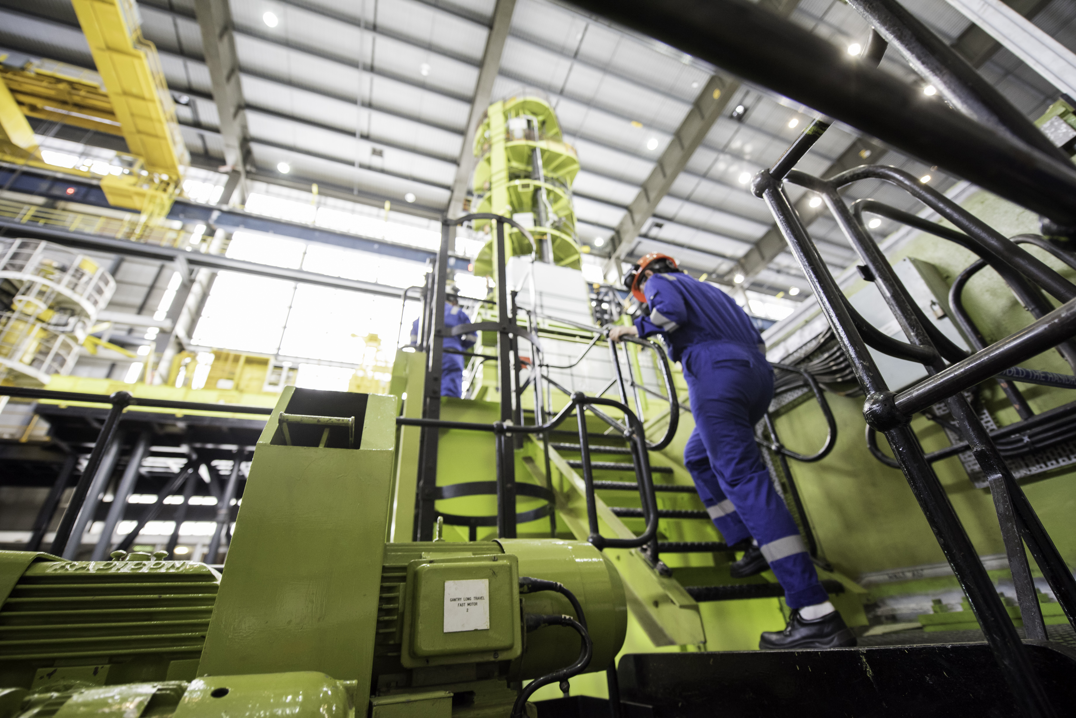
Grow….
….includes AGR Transition & Transfer
Preparing to transfer seven Advanced Gas-cooled Reactor (AGR) sites from EDF Energy to the NDA, for NRS (site operator) to carry out decommissioning.
Optimising the site transition to decommissioning, relicensing the sites into NRS, and facilitating seamless transfer via EDF/NRS collaborative workstreams;
  Site transfer blueprints
  People
  Plant
  Processes & systems
  Funding
  Land
  Contracts & supply chain.

Slide 6
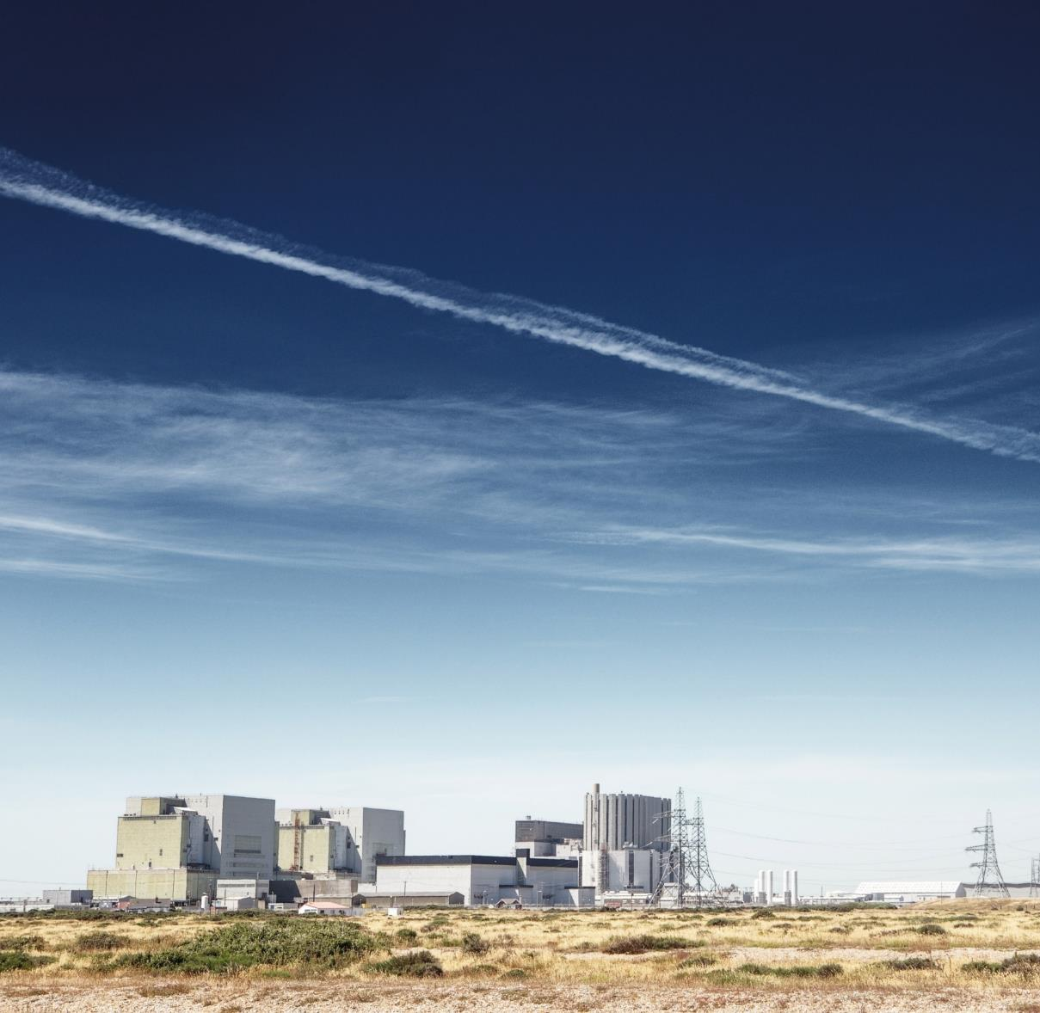

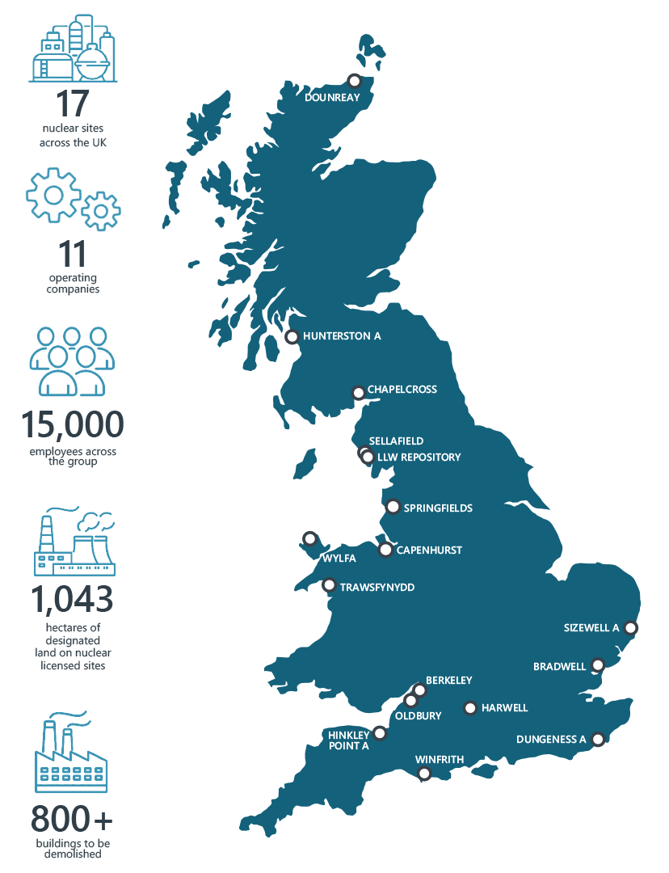
Our mission
We’re charged with the mission, on behalf of Government, to clean up the UK’s earliest nuclear sites safely, securely and cost effectively.
Doing this with care for our people, communities and the environment is at the heart of our work.
We’re committed to overcoming the challenges of nuclear clean-up and decommissioning, leaving our 17 nuclear sites ready for their next use.

Slide 7
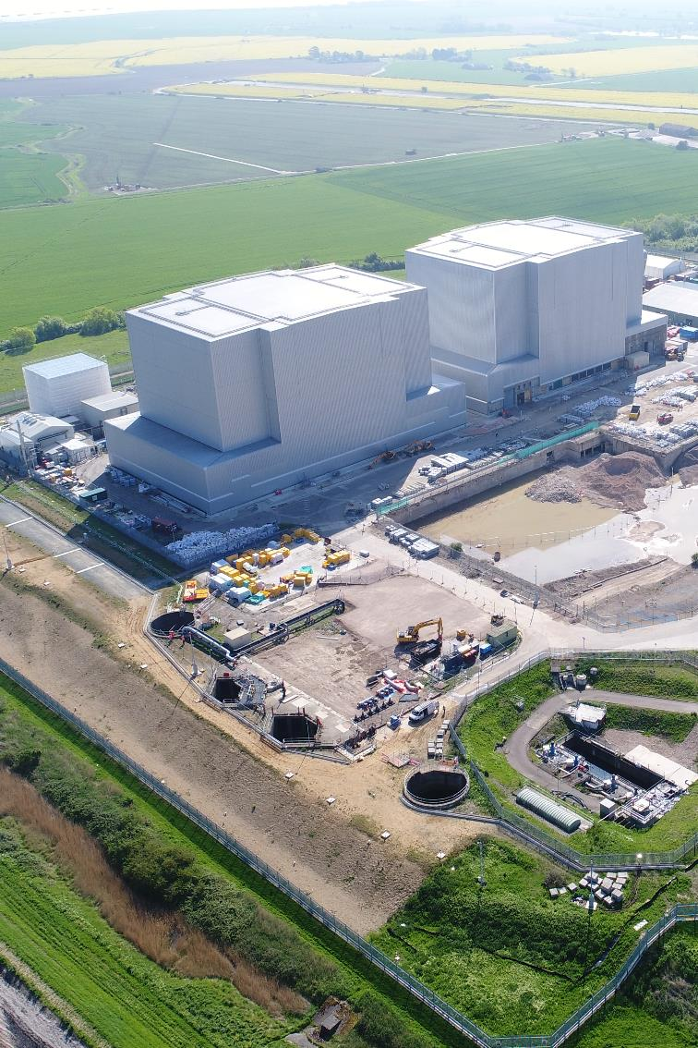
Strategic Alignment across the group
NDA, NRS and EDF are working closely to ensure that we enable a seamless transfer and seek to realise synergies from a combined fleet of reactors
Key points to note:
Pre-transfer, EDF is the licensee. Post transfer, the licensee will be NRS.
The NDA group are sharing lessons learnt from our progress to date to inform EDF’s plan development
We have started to realise synergies from a combined approaches (e.g. shared waste stores at A&B station sites)
We are working together to refine site specific decommissioning plans for transfer
Plans at the point of transfer will be refined for the short-medium term, and NRS will optimise for the long-term post-transfer

