Slide 1
Ensuring Effective NDA Community and Stakeholder Engagement
– The Nuleaf View
Presentation to Nuleaf Annual Meeting June 2024
Steve Smith
Consultant

Slide 2
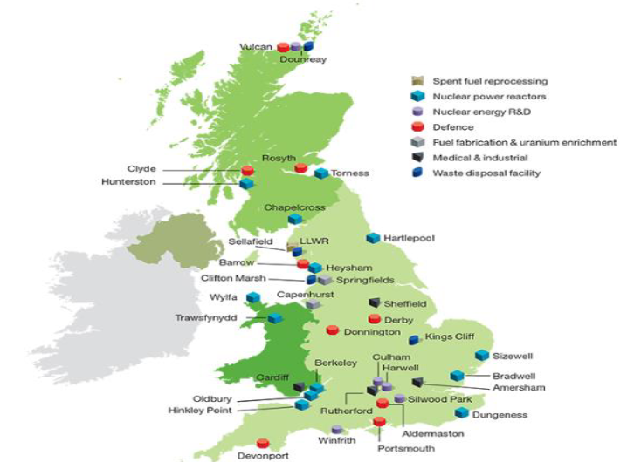
Ensuring Effective NDA Community and Stakeholder Engagement – The Nuleaf View
Introduction and Background to Study
Purpose
Proposal/Process/Timescales/Outputs
Workshop

Slide 3
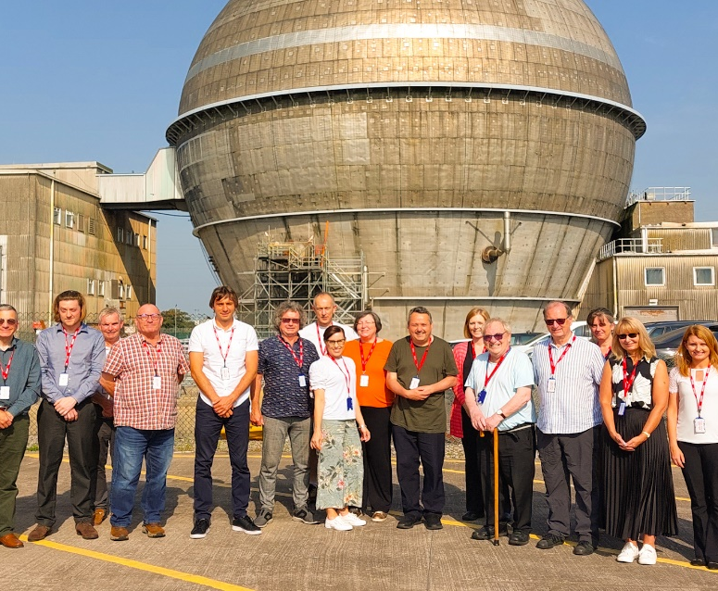
Ensuring Effective NDA Community and Stakeholder Engagement – The Nuleaf View
Introduction and Background to Study
NDA established in 2004 via the Energy Act
Included a requirement to engage with local communities
Much has changed since then – more change in the future – eg decom of AGR fleet
Local authorities are key stakeholders for NDA
Nuleaf key role in facilitating views of local authorities on nuclear legacy issues
NDA SSG study

Slide 4
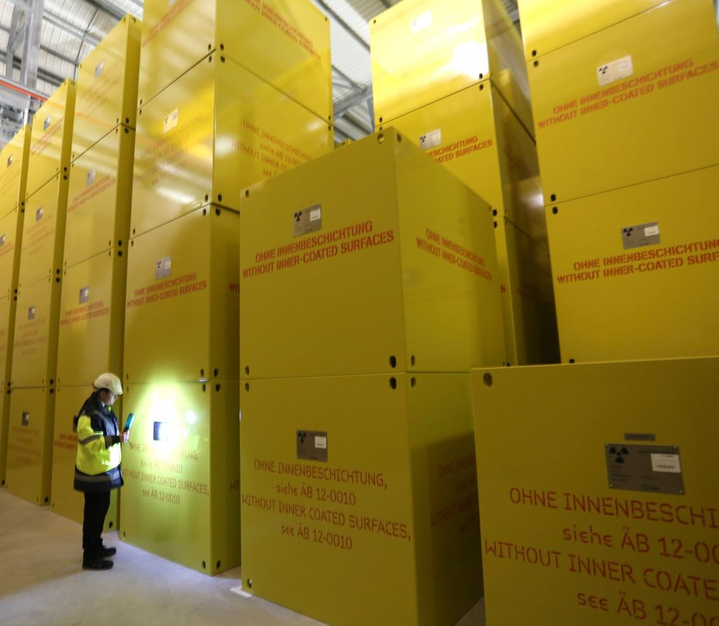
Ensuring Effective NDA Community and Stakeholder Engagement – The Nuleaf View
Purpose of Study
Consider current stakeholder landscape and assess
effectiveness of current arrangements for stakeholder
engagement
Gather views from Nuleaf members on current and
future NDA local authority and community engagement
activities
Review best practice nationally and internationally – in terms of comparable industries and other countries nuclear engagement
Help shape NDAs approaches to stakeholder engagement in the future
Set out a clear role for Nuleaf within the evolving stakeholder landscape, one that supports local engagement by our member authorities and complements SSG etc
Raise the profile of Nuleaf with existing and potential local authority members

Slide 5
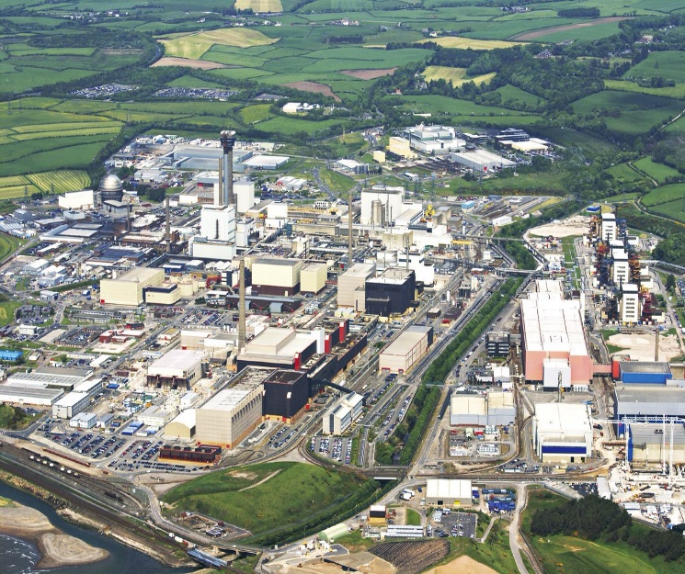
Ensuring Effective NDA Community and Stakeholder Engagement – The Nuleaf View
Proposal/Process/Timescales/Outputs
3 phases
1 assess effectiveness of current arrangements for stakeholder engagement across the NDA estate and assess effectiveness of Nuleaf representing Local Authorities.
2 in depth and wider consultation with current stakeholders and interested communities
3 Report from study and recommendations for Nuleaf and partners to consider aiding future decision making/thinking on stakeholder engagement.
Study carried out by Doug Bamsey and Steve Smith
Commence in June – report available September
Today’s workshop part of phase 1 – capture Nuleaf members initial views

Slide 6
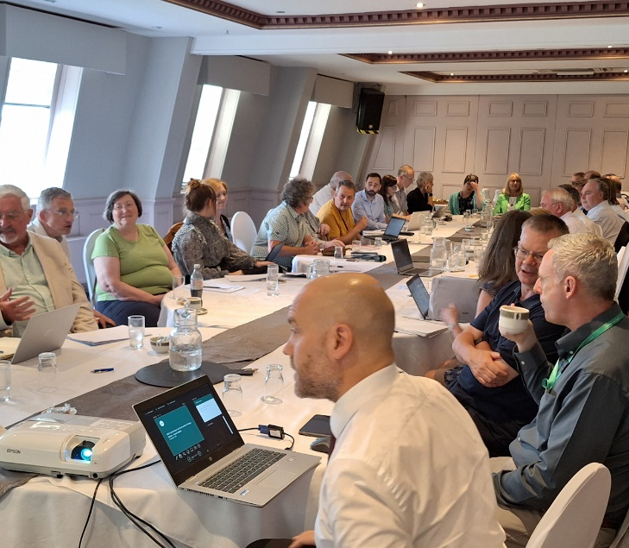
Ensuring Effective NDA Community and Stakeholder Engagement – The Nuleaf View
Workshop
Split into 4 groups
Record your views on flip chart
45minute discussion in those groups
4 key questions
What, in your view, are the key issues affecting
effective local authority, Nuleaf and wider stakeholder
engagement with the NDA?
Does your Council engage in stakeholder engagement activities with other sectors/partners which you see as exemplars of good practice and why?
Are there new techniques for stakeholder engagement that you suggest would be appropriate for NDA to consider employing?
What changes would you like to be considered to improve the effectiveness of Nuleaf to represent the views of local authority member Councils and their communities through engaging with the NDA?

Slide 7
Ensuring Effective NDA Community and Stakeholder Engagement – The Nuleaf View

Slide 8
Thank you
Contact: Philip Matthews
Executive Director
philipmatthews@nuleaf.org.uk
07949 209126
@nuleaforguk
www.nuleaf.org.uk

