Slide 1



Gwynedd Covid Economic Recovery Programme

Slide 2
Focusing on 3 areas of the economy:
Major Recovery
Supporting the development of:
Business Recovery
Project Recharge
Workforce Recovery
In-work Poverty
Business Engagement Strategy
Llanbedr Airfield
Business Grant Package
Trawsfynydd Nuclear Site

Slide 3


Major Recovery | Trawsfynydd Site
EGNI Programme
As part of this programme, the Egni team at M-SParc has been visiting schools across Gwynedd to educate the pupils on the importance of low-carbon energy.
In groups, the pupils must design and manage a village’s electricity supply and balance the supply between various low-carbon sources, of which nuclear energy is essential for a reliable and constant source of energy.
The purpose of this exercise is to educate the pupils on the various sources of carbon energy and the strengths and weaknesses of each source.
This emphasises the importance of having a low-carbon energy mix for a more sustainable future.
Notes:
We also fund the extension of the MSParc’s EGNI Programme into Gwynedd.
Children

Slide 4
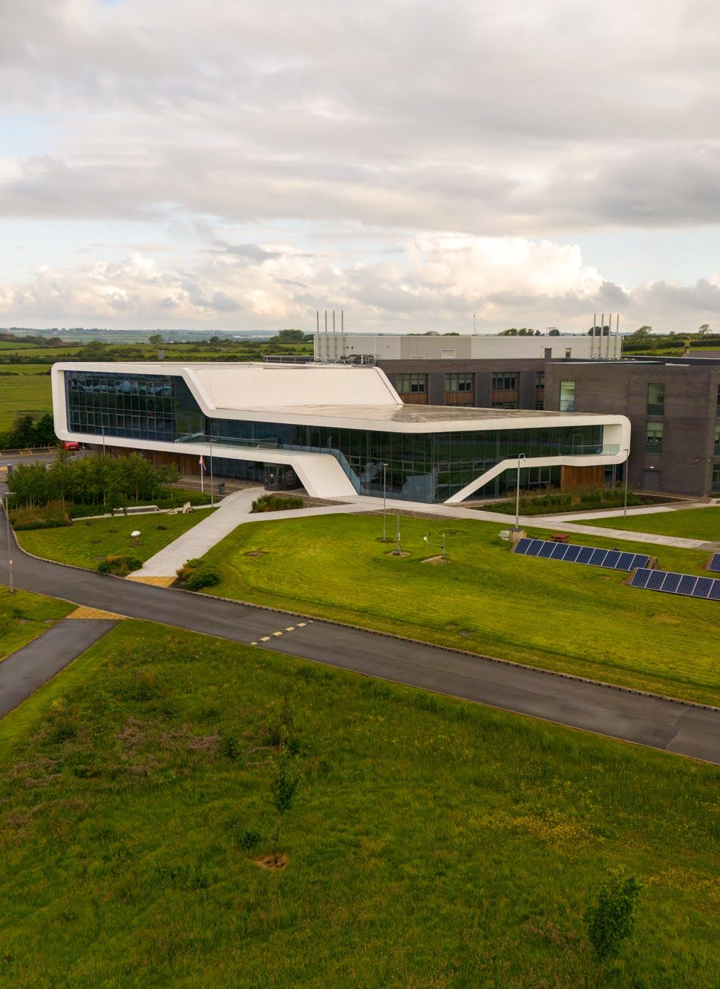

Major Recovery | Trawsfynydd Site
Educational Videos
In partnership with Cwmni Egino, we have been working with M-SParc to develop educational videos on various aspects of nuclear energy, and the potential that SMRs have to offer.
The themes include:
What is Nuclear?
Big v Small
Waste
Radiation
What’s in it for Us?
The Energy Mix
Notes:
Fideos: Fideos Niwclear.docx

Slide 5
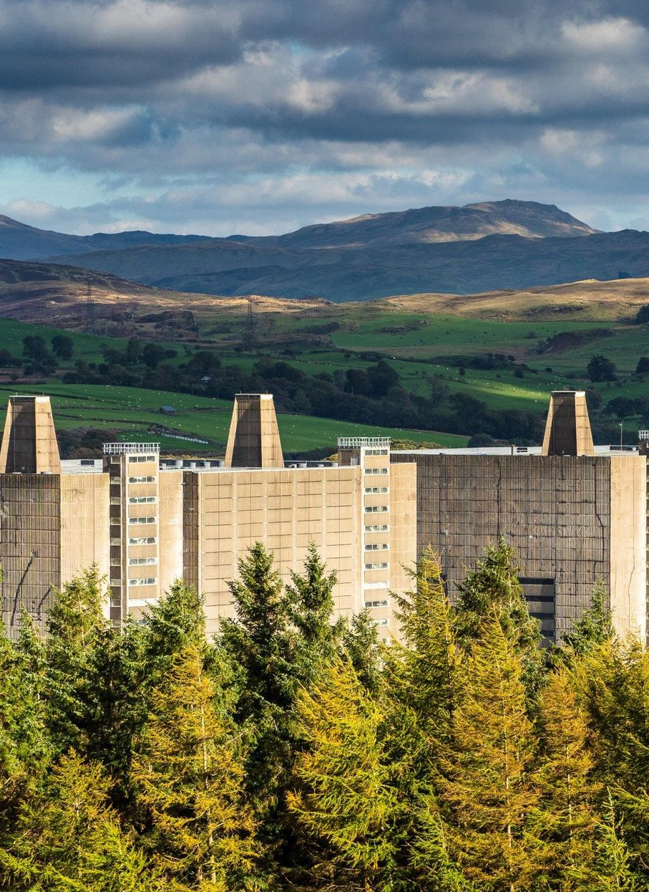
Major Recovery | Trawsfynydd Site
Community Narrative Project
We commissioned a local consultancy group to undertake a community narrative research into local people’s memories and perceptions of the Trawsfynydd Nuclear site.
25 one-to-one and 8 group interviews conducted, as well as an online questionnaire published.
Findings:
Acknowledgment of the employment and skills opportunities provided by the site
Greater prosperity in local communities during operation years.
Fostering community cohesion by retaining local talent
Generational gap in opinions
Notes:
This report will be helpful in supporting the case for further development on the site, and similarly for all sites which have a nuclear legacy.
Briff: Invitation to Tender - Trawsfynydd Community Narrative Project.pdf
Tendr: Tendr Naratif Cymunedol Trawsfynydd - LAFAN_compressed.pdf

Slide 6
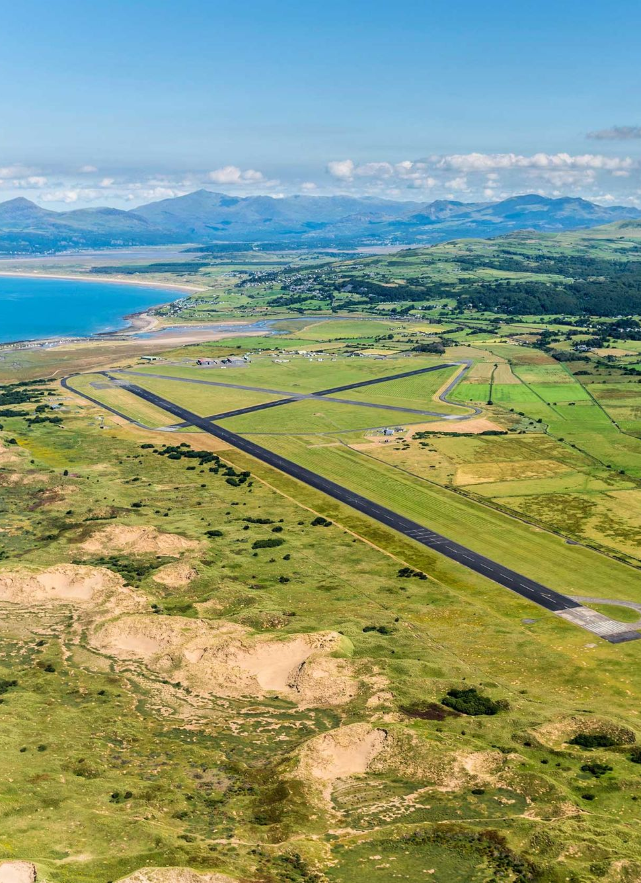
Major Recovery | Llanbedr Site
Llanbedr Airfield
We also have plans to assist the development an ex-RAF base in the south of Gwynedd.
Being developed as Snowdonia Aerospace Centre.
Identified as having all the necessary characteristics to host a Spaceport.
The site hosts many businesses in its buildings, including a flight school, in addition to being a testing centre for unmanned aerial vehicles (UAVs).
It has the potential to host many other projects, such as a proposed dark sky observatory.
Efforts are underway to secure resources to build a bypass around the village of Llanbedr to unlock the potential of this site.
Notes:
O’r hawliad olaf:
“Of the 20 buildings to be renovated or demolished, work has been completed at 12, and is under way at a further 2. The rest of the work is tied to the wider developments and new access road explained above. We continue to work with all key partners to try to unlock this key development and allow works on site to be completed, for example, a meeting was held between our Council Leader Dyfrig Siencyn and the Deputy Minister for Climate Change Lee Waters which resulted in an agreement to look for alternative means to enhance access to site.
WelTAG evaluation is underway to explore posible options to improve transport in Llanbedr.
”
£950k invested in site to date.

Slide 7

Business Recovery
Project Recharge
Project Recharge is our business diversification scheme which aims to improve the resilience of our micro/SMEs which were affected by recent economic events.
Mentors work with local businesses to review their current skills and resources, and identify ways to maximise their potential, such as being more efficient, diversify into other sectors, training opportunities, etc.
As of now, 36 businesses have registered for the scheme.

Slide 8

Business Recovery
Business Engagement Strategy
Delivering an engagement strategy that responds to the needs of Gwynedd’s businesses.
Activities include:
Digital Engagement via Social Media
Conducting surveys
Developing an online Inquiries system
Gwynedd Business Week
Organising and attending events
Site visits
Drop-in sessions in town centres

Slide 9
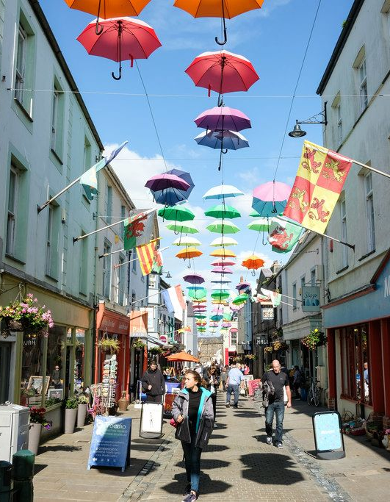
Business Recovery
Business Grant Packages
We have created 2 grant funds opened to support our businesses:
Business Development Fund
  Spark – Up to £25,000 to develop viable businesses in a new direction or to save costs – light assessment process
  Transform - £25,000 - £250,000 for the same purpose – thorough assessment Process, competitive.
Town Centre Property Improvement Grant
  Again, up to £25,000 to improve the facade of commercial properties in town centres
  £25,000-£250,000 for the same purpose – thorough assessment process, competitive
Notes:
4 different grants
Business Development
Property Improvement Grant

Slide 10

Business Recovery
Business Grant Packages
Grant | #
Spark | 34
Transform | 10
Property Improvement (Small) | 12
Property Improvement (Big) | 3
 | 59
£2m worth of grants allocated.
£1.25m of additional match Investment into the economy.
Notes:
4 different grants
Business Development
Property Improvement Grant

Slide 11
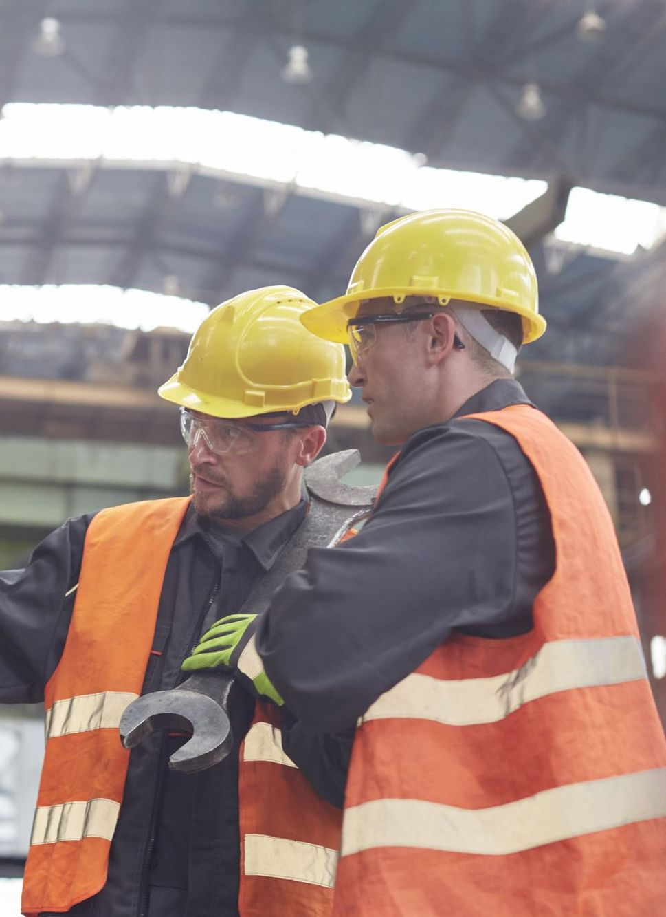

Workforce Recovery
In-Work Poverty Assistance
Programme where the Council helps individuals experiencing in-work poverty.
Assistance includes:
Identifying barriers to better employment
Assisting with CVs and job applications
Enrolment and payment for training
Childcare costs
Regular catch-ups
As of now, 53 individuals have received assistance, 12 have undergone training, and 11 have moved on to better employment.

Slide 12
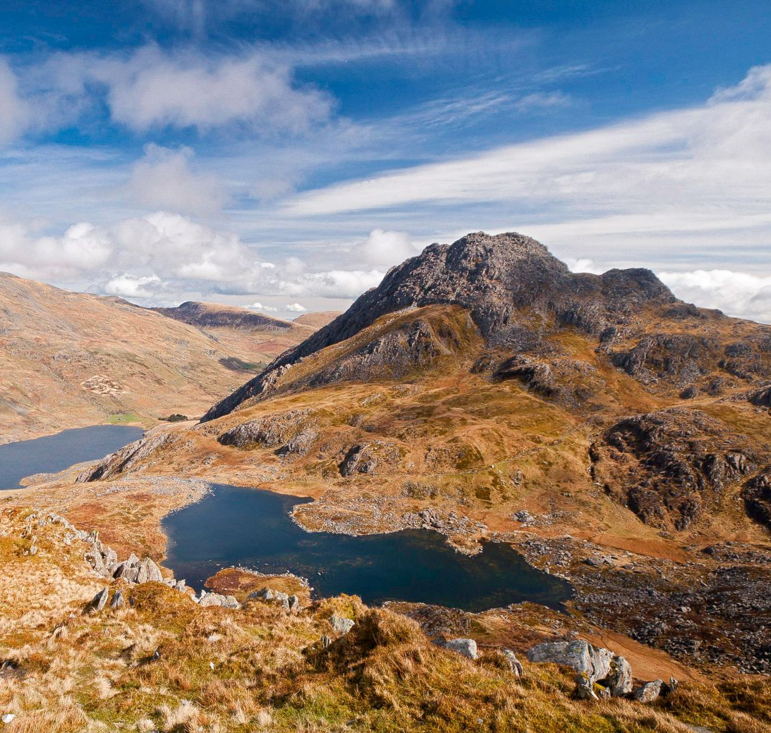
Looking Forward
Programme designed in 2020
Much has changed since then
With NDA support we have been able to respond quite nimbly to changes
We have also learned many lessons which will allow us to plan future programmes

Slide 13
Diolch!

