Slide 1
Ensuring Effective NDA Community and Stakeholder Engagement
– The Nuleaf View
Presentation to Nuleaf Steering Group September 2024
Steve Smith Doug Bamsey
Consultants

Slide 2
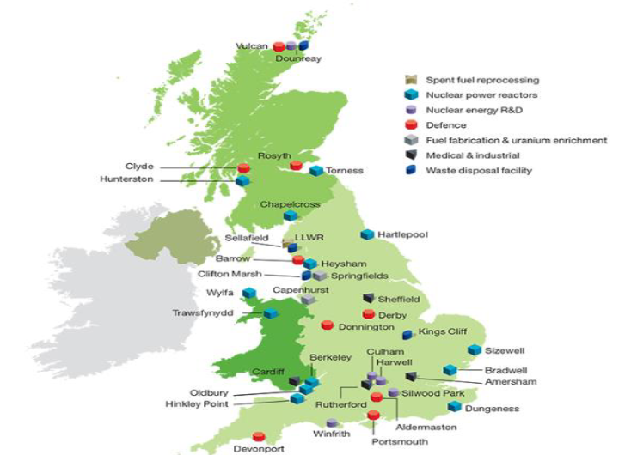
Ensuring Effective NDA Community and Stakeholder Engagement – The Nuleaf View
Purpose of study - reminder
Progress to date
Emerging findings:
    effectiveness of NDA stakeholder engagement across the NDA estate with national and international comparisons
    The effectiveness of Nuleaf representing Local Authorities – views of LAs and Nuclear sector
Discussion

Slide 3
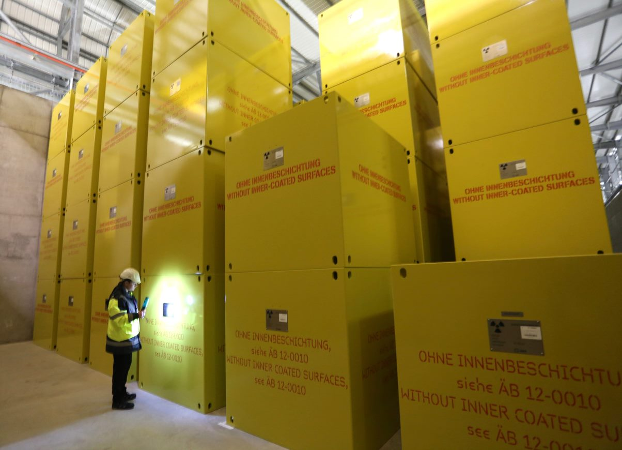
Ensuring Effective NDA Community and Stakeholder Engagement – The Nuleaf View
Purpose of Study – a reminder
Consider current stakeholder landscape and assess
effectiveness of current arrangements for stakeholder
engagement
Gather views from Nuleaf members on current and
future NDA local authority and community engagement
activities
Review best practice nationally and internationally – in terms of comparable industries and other countries nuclear engagement
Help shape NDAs approaches to stakeholder engagement in the future
Set out a clear role for Nuleaf within the evolving stakeholder landscape, one that supports local engagement by our member authorities and complements SSG etc
Raise the profile of Nuleaf with existing and potential local authority members

Slide 4
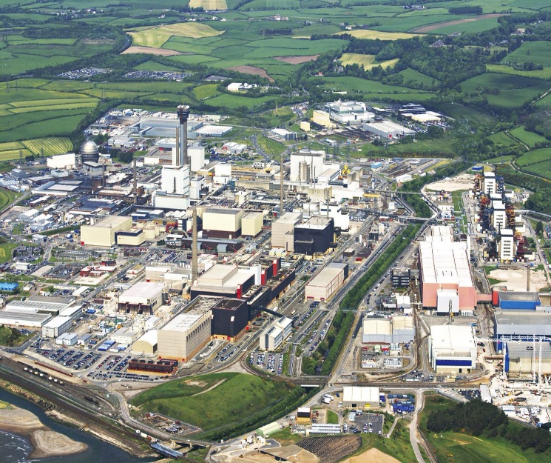
Ensuring Effective NDA Community and Stakeholder Engagement – The Nuleaf View
Proposal/Process/Timescales/Outputs - a reminder
3 phases
1 assess effectiveness of current arrangements for stakeholder engagement across the NDA estate and assess effectiveness of Nuleaf representing Local Authorities.
2 in depth and wider consultation with current stakeholders and interested communities
3 Report from study and recommendations for Nuleaf and partners to consider aiding future decision making/thinking on stakeholder engagement.
Today’s meeting – emerging findings from phases 1/2 – for Nuleaf members’ information and thoughts.

Slide 5
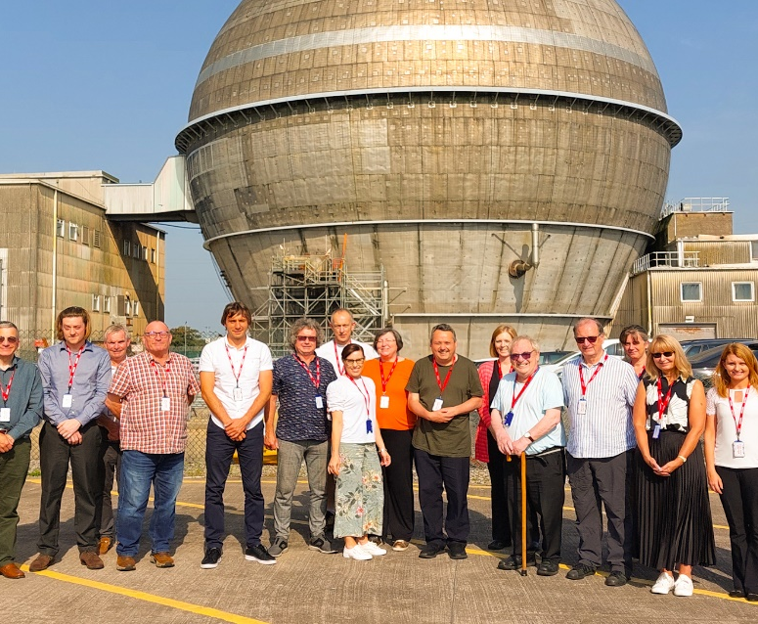
Ensuring Effective NDA Community and Stakeholder Engagement – The Nuleaf View
Other NDA funded studies underway
Review of the effectiveness of SSGs
Can Citizen Participation techniques be used to benefit stakeholder engagement.

Slide 6
Stakeholder engagement – a national comparison
National organisations as comparators
ONR
NIA
National Grid Electricity Transmission
EDF
Oil and Gas Authority
Progress to date
Any initial key observations

Slide 7
Stakeholder engagement – a national comparison
Initial headline observations
Approaches can be reactive or proactive – policy orientated and consultative
Some resource expensive – others not!
Expected range of activities and methods
Some approaches obligated – some driven by commercial opportunity and stakeholder/member expectations
Aim to ensure “public confidence” - through openness and transparency
Regular assessment of stakeholders' views
Challenges of internal dissemination
Ref to AA1000 AccountAbility Stakeholder Engagement Standard (2015)

Slide 8
Stakeholder engagement – an international comparison
International organisations as comparators
Finland – Eurajoki Municipality and Posiva
Holland – Borsele Municipality and Covra
Sweden – Osthammer Municipality, SKB and KSO
Canada – Municipality and NWMO
Progress to date
Any initial key observations

Slide 9
Stakeholder engagement – an international comparison
Initial key observations
Municipalities very positive about relationship with RadWaste Management Company (RWMCo) – access to CEO if needed
Openness and trust fundamental – do what you said you would do – legal basis of agreements
Long term relationships – better established by in-person contact – open meetings especially in early days of process – later use of social media
RWMCo – invest in locality – be seen on the patch “learnmore centres” – dedicated officials – use of local businesses – use of local offices – employ local people
Process is as important as information
Engaging with young people and hard to reach groups
Positive economic impact – in some communities over 80% support the industry – annual survey of local residents to test satisfaction
Added value programme – inc sponsorship, Summer festival of activities, support to local infrastructure
Maintain database of all engagement activities and comments received
High quality and updated visuals

Slide 10
The Effectiveness of Nuleaf Representing Local Authorities
The Local Authority view:
Good high-level understanding of role and function of Nuleaf
Without Nuleaf no/limited confidence would be as effective engagement with NDA. A two-way conversation
Counters “isolation” of nuclear officers in LAs
Meetings very valuable – access to Nuclear industry, important source of information and knowledge
Gives a basis to participate in/understand the nuclear sector – new members supported in learning
Site visits very valuable
Gives the context within which local nuclear sites exists
Consultation responses important on behalf of LAs and assisting individual responses
Brings together the Nuclear Local Authority family – with differences and similarities
A stronger combined voice, shared experience/knowledge
Well respected Director

Slide 11
The Effectiveness of Nuleaf Representing Local Authorities
The Local Authority view:
Variable degree to which Members involved/senior managers aware of Nuleaf – information not disseminated consistently
Scope to do more, be more proactive (e.g. - consultee for Local Plan), stimulate shared/knowledge/ambition of LA members
Should/could have a higher profile/clearer purpose/greater recognition
Language/format of meetings may not always be conducive to maximum participation/understanding for ”newer” participants.
Large number of LAs in total membership – much smaller group of fully participating LAs – a positive and/or negative?
Barriers to membership?
Scope of Nuleaf to be involved in new nuclear/work with NNLAG – differing views
Relationship to NFLA – important/reassess/recalibrate?
SSGs – important and valuable - variable involvement/understanding/perception – ideas for change

Slide 12
The Effectiveness of Nuleaf Representing Local Authorities
NDA/RWM/ONR view
Good high level understanding of role and purpose of Nuleaf
Nuleaf valued for LA perspective it gives
Gives valuable dialogue with LAs, ability to build long term relationship.
Good/open communication with Nuleaf – an honest broker
Representative – in terms of legacy site – less so for operational sites
How respond/adapt to nuclear new build – a new geography/new LAs?
Reaching out on Geological Disposal siting potential areas positive.
UK wide involvement – role in Scotland – important
Well respected Director

Slide 13
The Effectiveness of Nuleaf Representing Local Authorities
NDA/RWM/ONR views
Nuleaf take a higher profile – facilitate the debate?
Nuleaf be more proactive in involving other stakeholders, to promote engagement, to make more/develop greater connections within and outside the nuclear sector?
Nuleaf encourage the Local Authority ambition – the full potential of outcomes that could be possible?
Increase the Local Authority reach – across the nuclear geography – as exists and as may exist
NFLA – differences as compared to Nuleaf – an NGO, who do they represent – competing or complementary, alternative routes for NFLA voice to be heard?
NWS/ONR – SSGs very variable – ideas for change

Slide 14
Discussion

Slide 15
Thank you
Contact:
Steve Smith
Doug Bamsey
steve.smith@hortonsmithltd.co.uk
douglasmontagub@gmail.com
07871 148863
@nuleaforguk
www.nuleaf.org.uk

