Slide 1
Nuleaf: International engagement update
Steering Group meeting, 11th December 2024
Philip Matthews
Executive Director

Slide 2
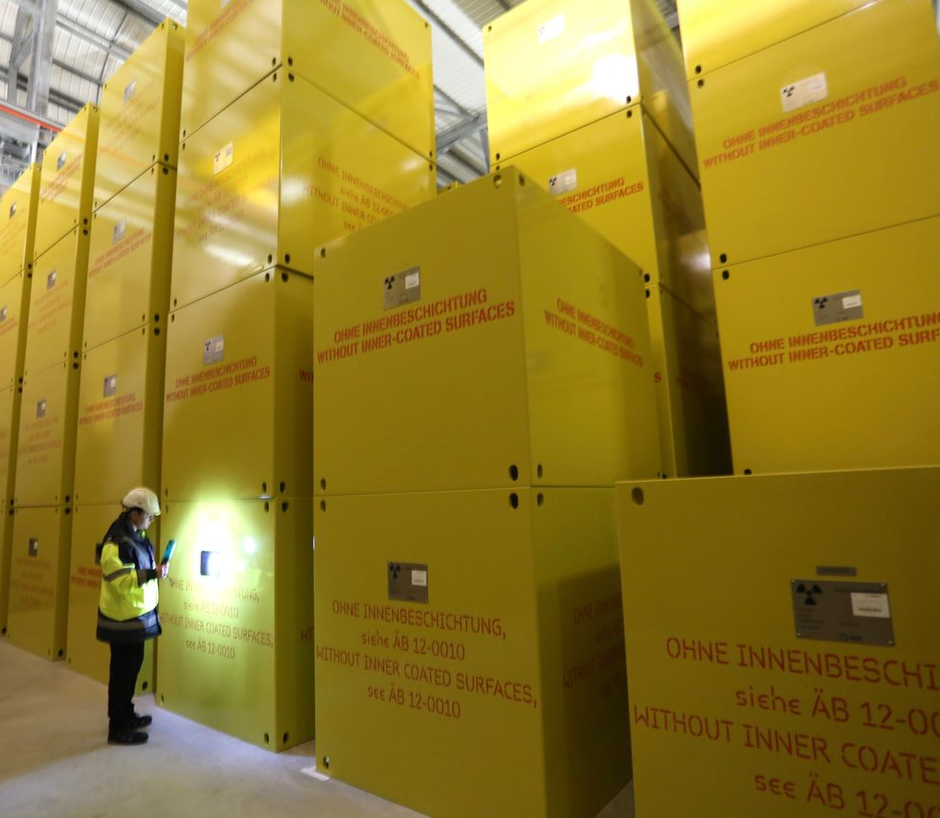
Overview
Nuleaf has undertaken international engagement for many year
This has developed since 2017 after the decision to join GMF Europe
Engagement now includes:
    GMF meetings
    IAEA events
    Other site visits
Nuleaf participated in EURAD programme – but is not engaged in EURAD2.
Wider international links are now developing – Global Partnership

Slide 3
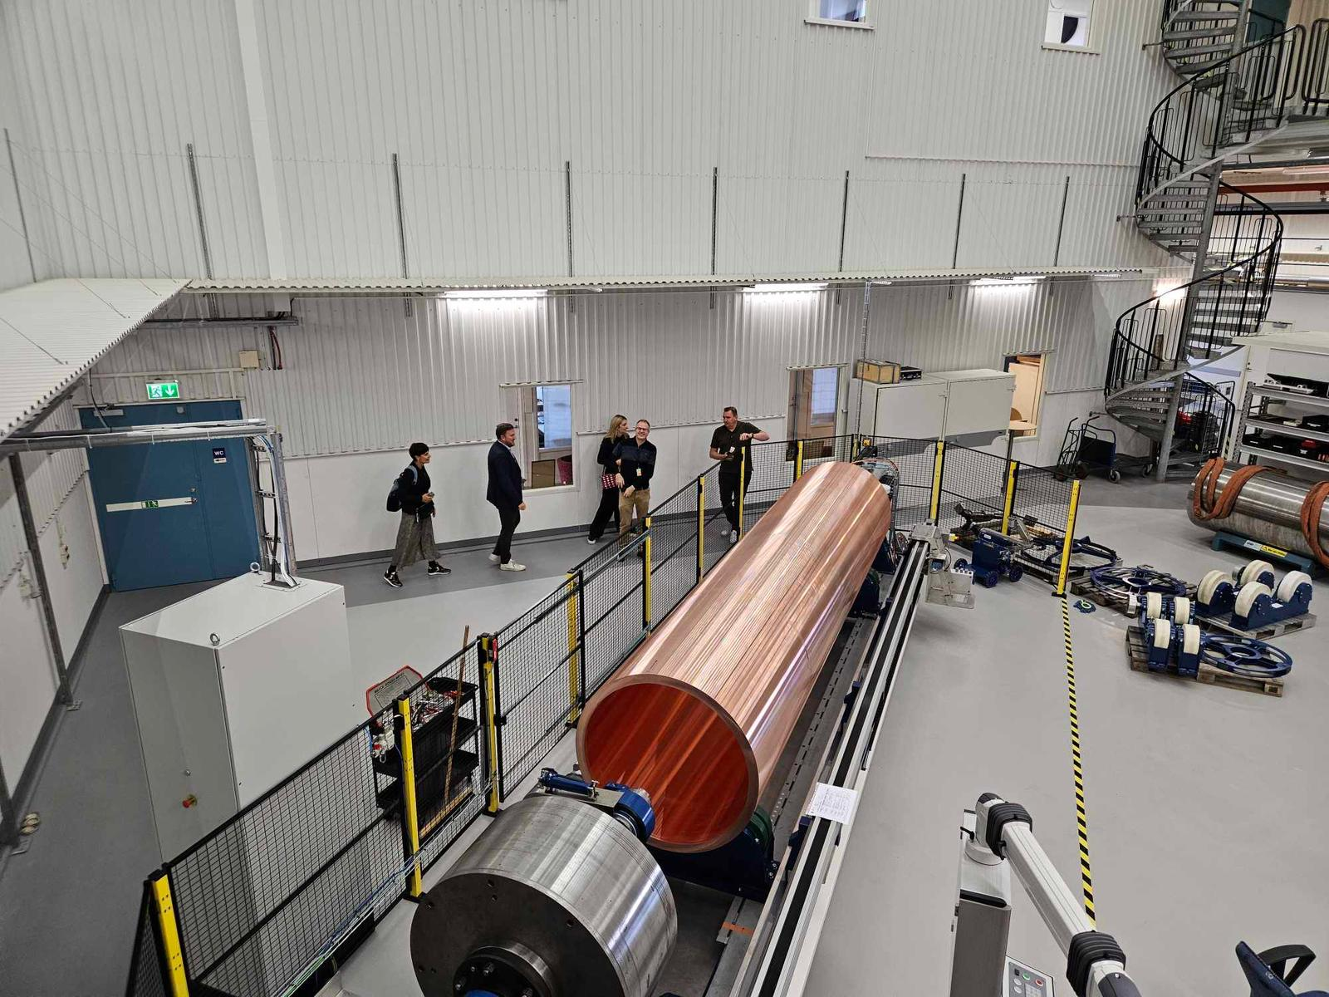
Oskarshamn
Swedish GDF siting process began in 1992
Every municipality in the country invited to take part. Eventually reduced to two communities – Osthammer and Oskarshamn
In 2022 the Forsmark site in Osthammer selected
Final go ahead expected shortly
Oskarshamn lost out but received 75% of community benefits and also canister factory. It is also the location of the Rock Lab.

Slide 4
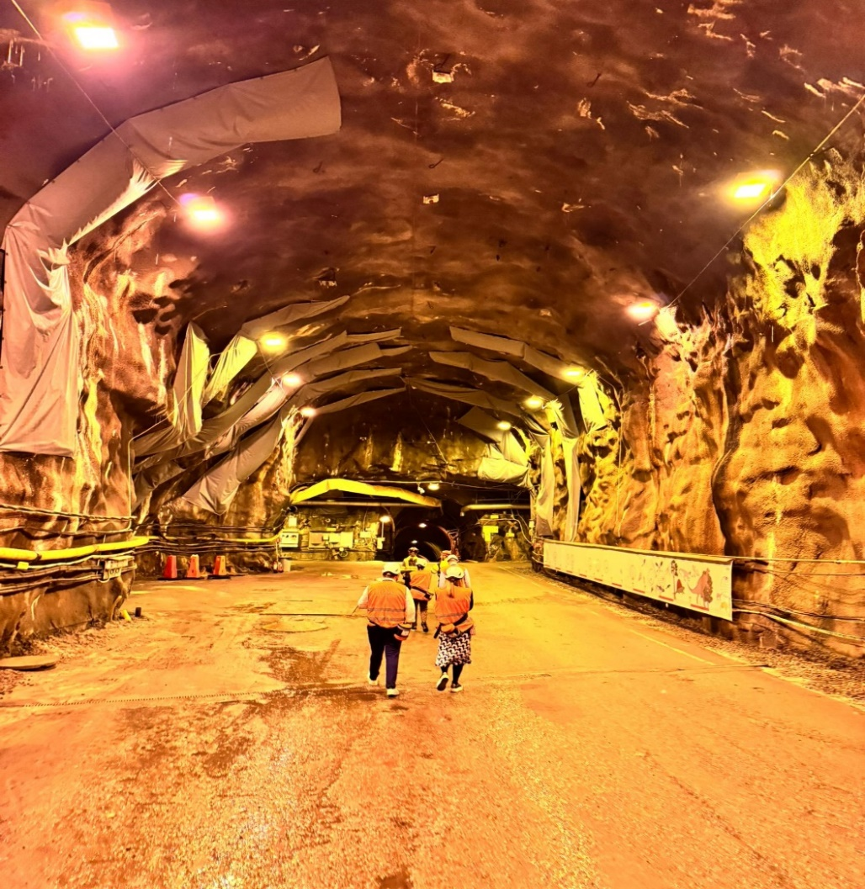
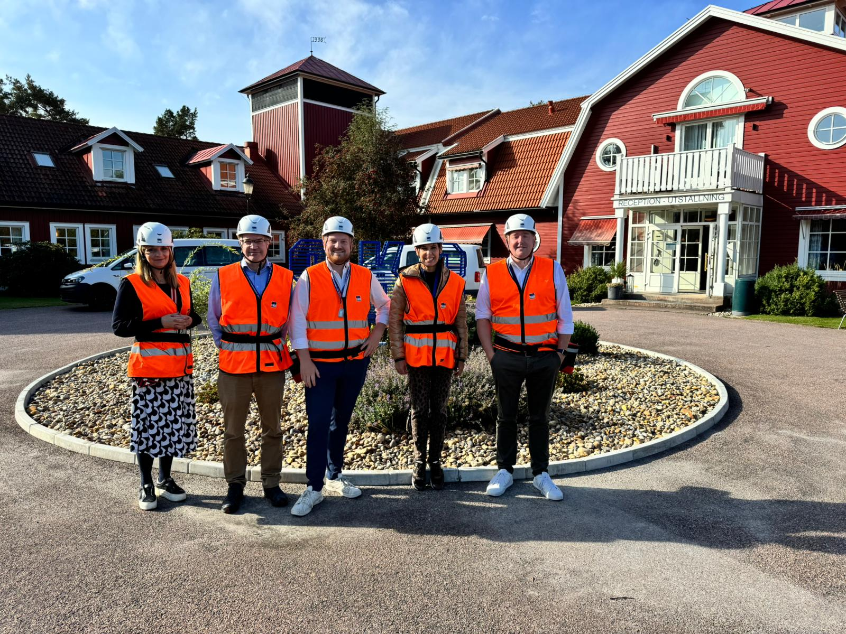
Aspo rock lab

Slide 5
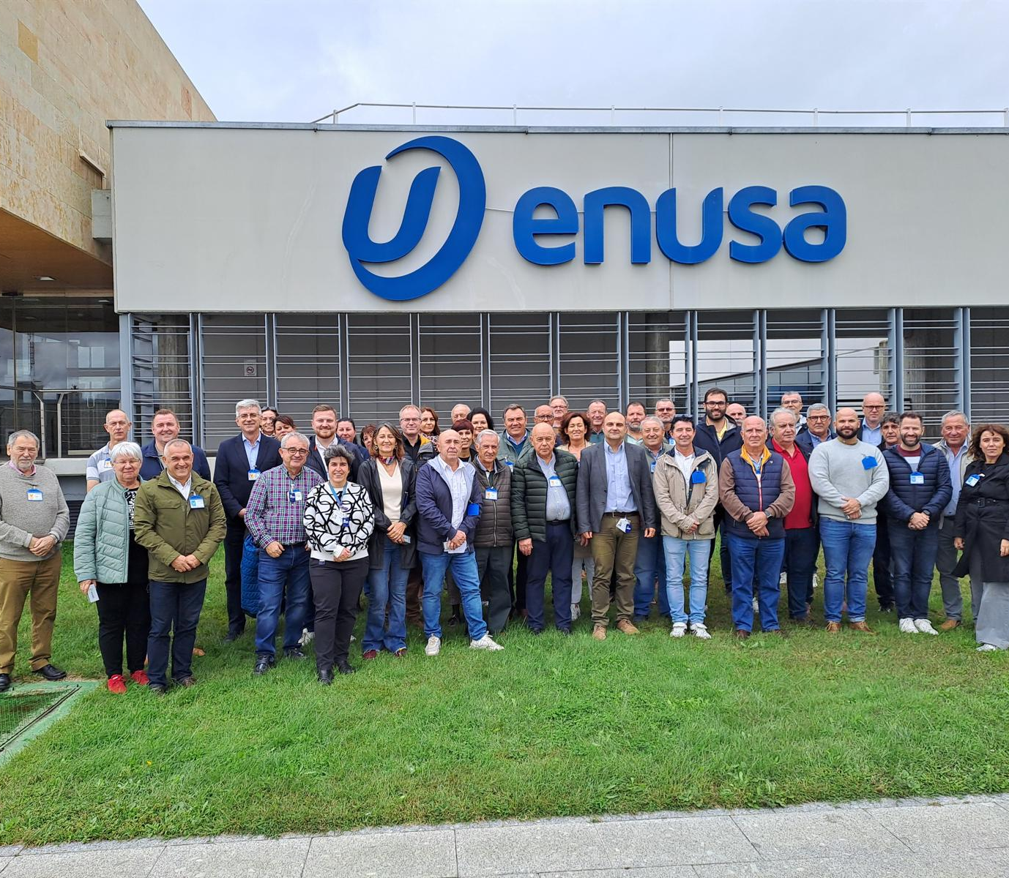
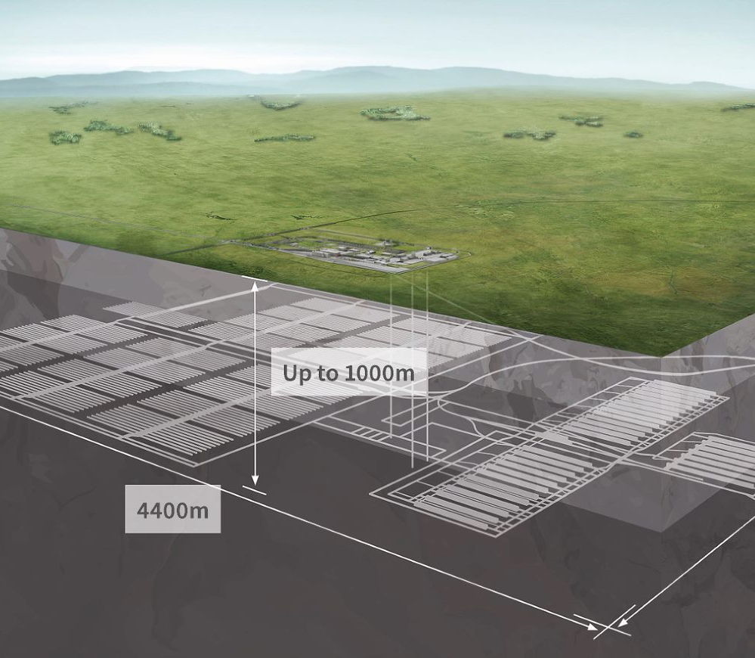
GMF General Assembly, Salamanca
GMF meets twice per year – in 2024 visit to Bugey in France; and General Assembly in Salamanca.
Agenda:
    GMF Strategy and future
    Community Agreements for nuclear across Europe
Site visit to ENUSA – nuclear fuel factory
Provides nuclear fuel assemblies to countries across Europe
Employs around 400 staff

Slide 6
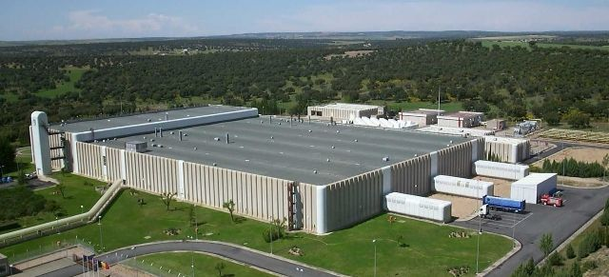
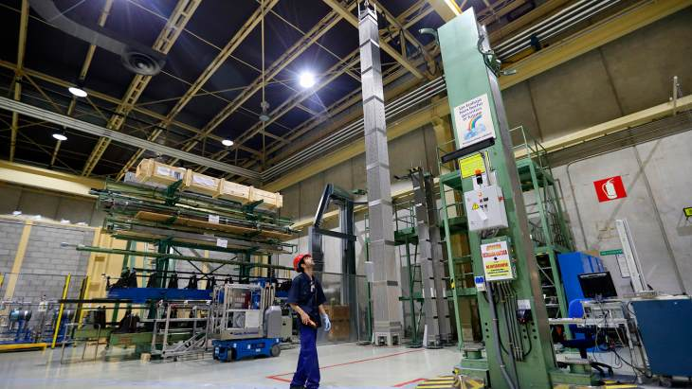
ENUSA Fuel Fabrication Plant

Slide 7
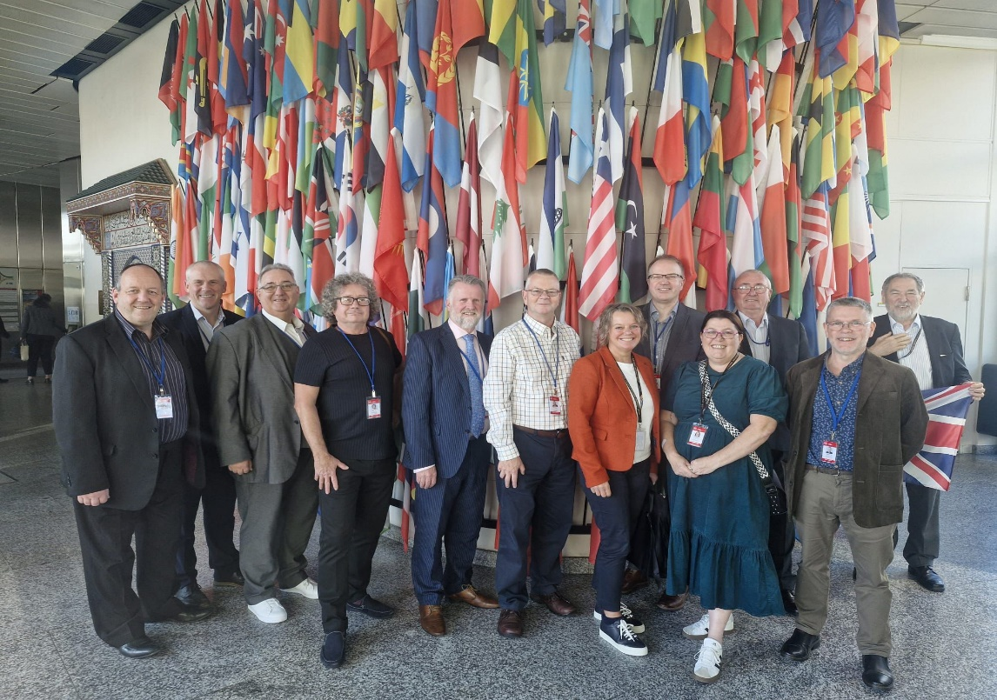
IAEA - Vienna
Large UK delegation – Nuleaf and NWS
Considering engagement across the nuclear cycle but focus on SMRs
Nuleaf active across the programme of the event
Build up to Global Conference in Vienna, May 2025
Further development of Global Partnership – Republic of Korea and Argentina affiliated

Slide 8
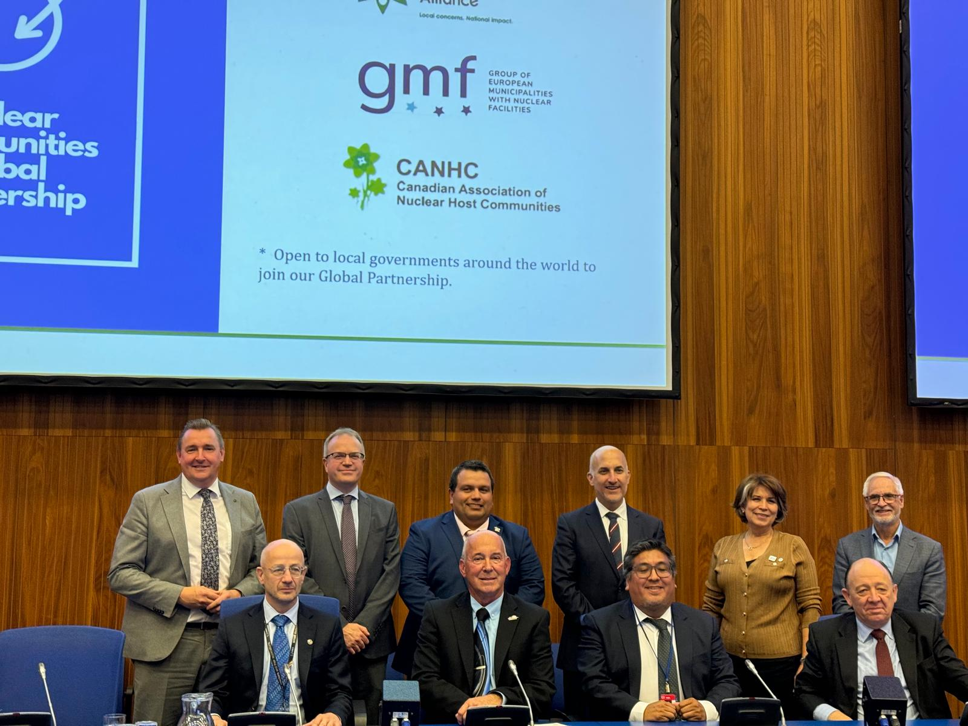
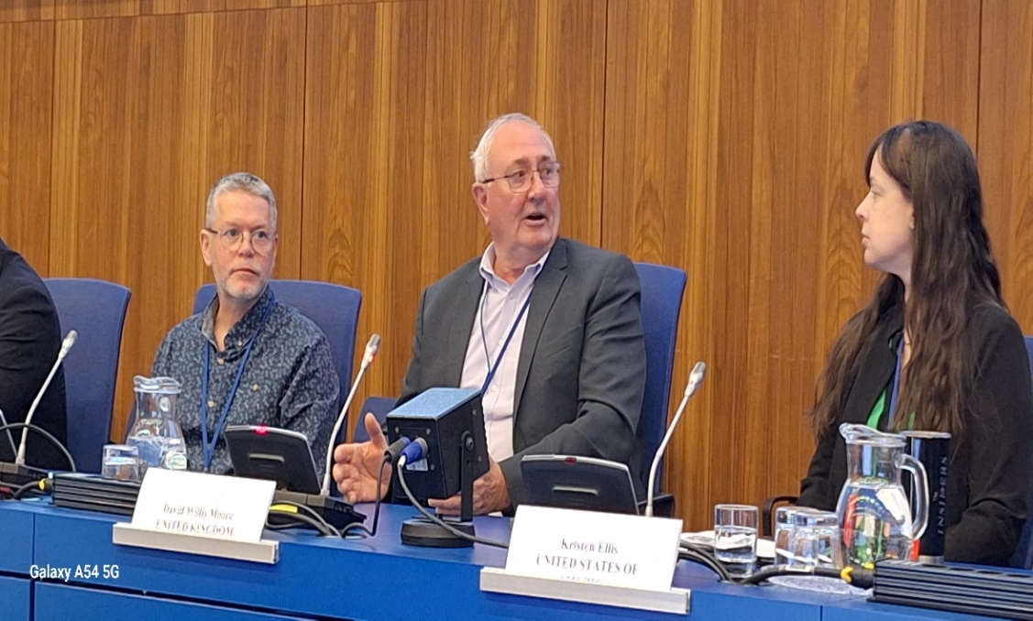
IAEA Technical Meeting - Vienna

Slide 9
Thank you
Philip Matthews
Executive Director
philipmatthews@nuleaf.org.uk
(44) 07949 209126
@nuleaforguk
www.nuleaf.org.uk

