Slide 1
Borsele Conditions Group, Netherlands
Presentation to Nuleaf Steering Group, 2nd December 2025
Philip Matthews
Executive Director

Slide 2
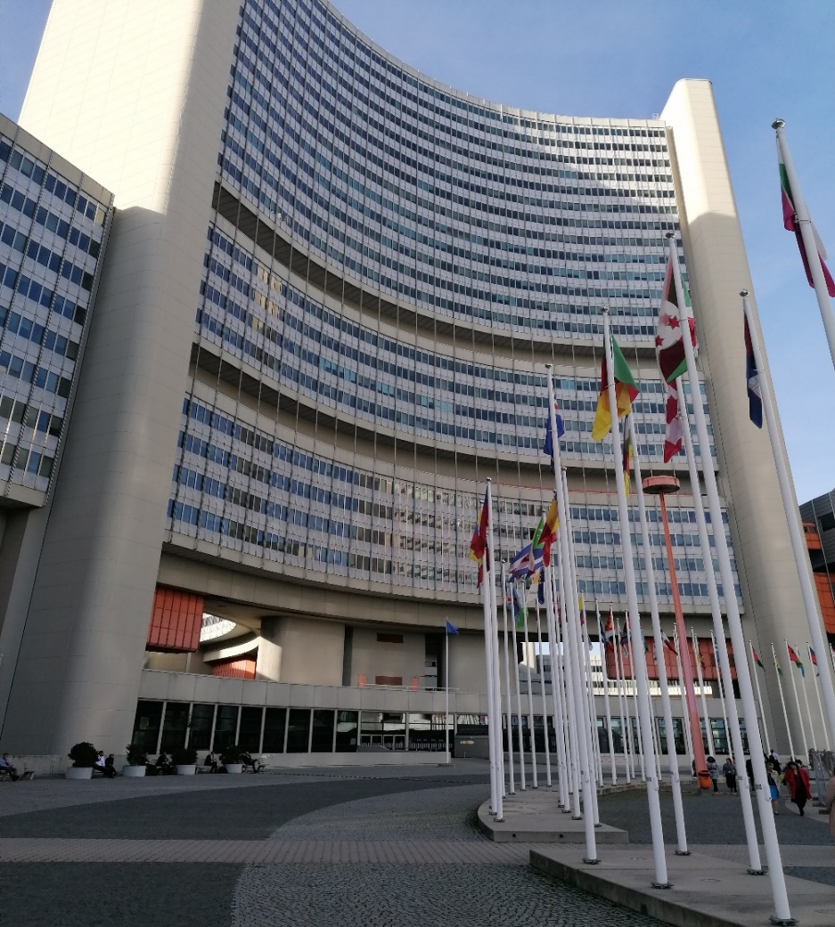
Our international engagement
GMF Europe – Joined 2017
IAEA – Developing programme on the local dimension to nuclear
Nuclear Communities Global Partnership – Nuleaf a founding member. Growing network.

Slide 3
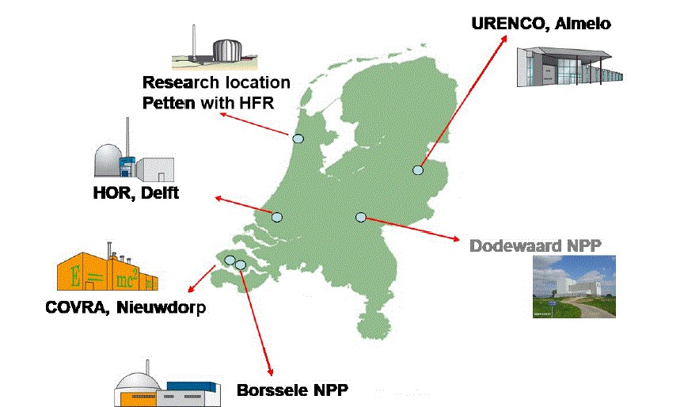

Slide 4
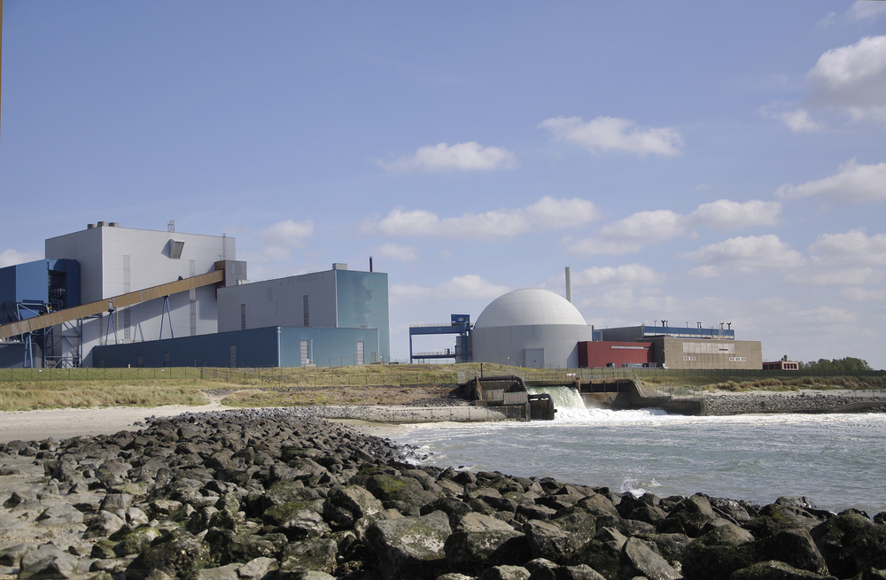
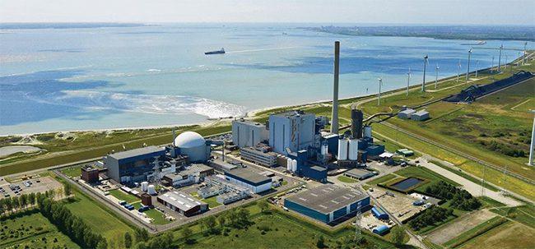
Nuclear generation in Borsele

Slide 5
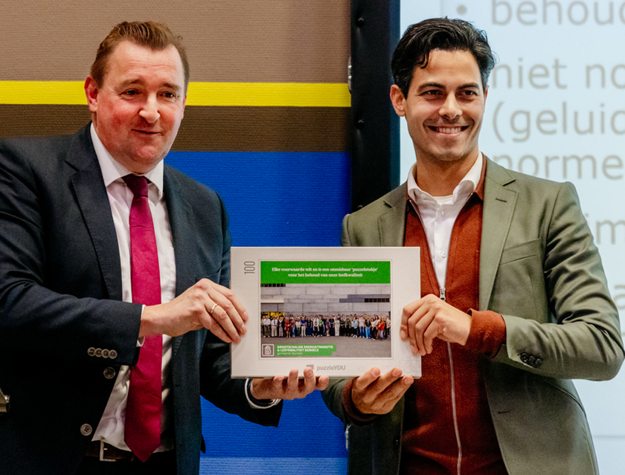
Borsele Conditions Group
Dutch Government has changed policy in recent years – commitment to new nuclear.
In 2022 announced plans for 2 new reactors on one site.
Borsele front runner but others now interested.
Other large energy projects also proposed for the municipality – grid changes most contentious.

Slide 6
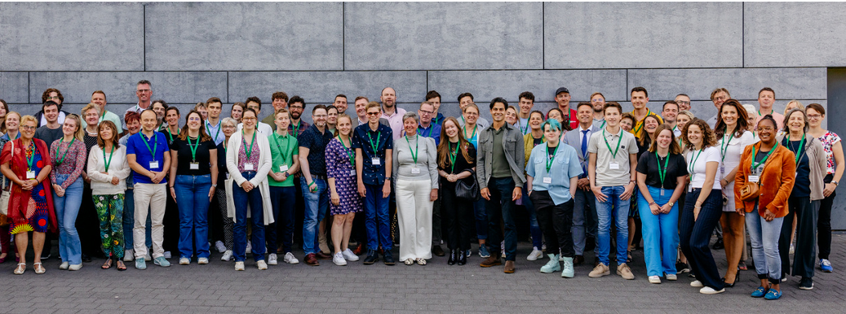
Borsele Conditions Group
Dutch

Slide 7
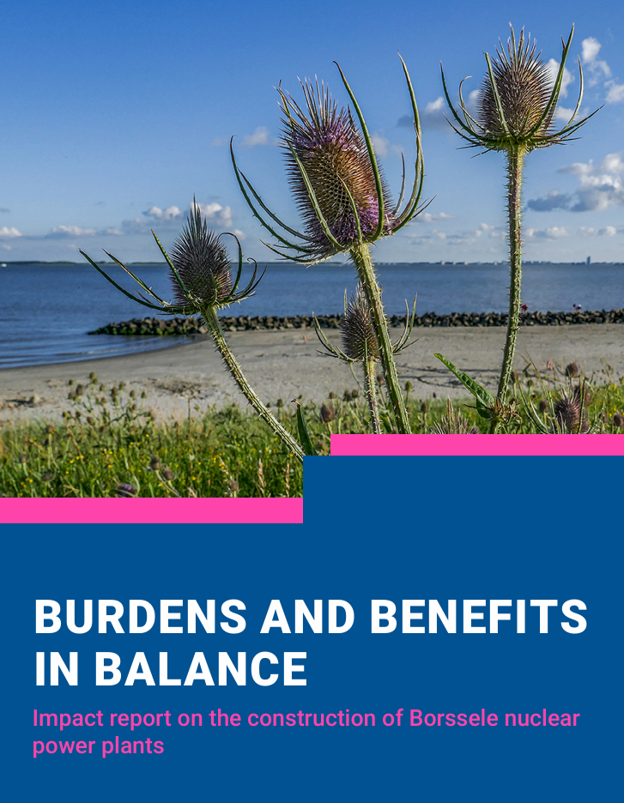
Borsele Conditions Group
Final decision on infrastructure with national government – but local authority wanted to understand and identify their ‘asks’ on key aspects.
Group covered wide range of issues from quality of life and landscape impacts to safety. Themes defined by Group.
15 local experts provided support.
Original group met 5 times in 2023
Undertook study visit to Hinkley Point C

Slide 8
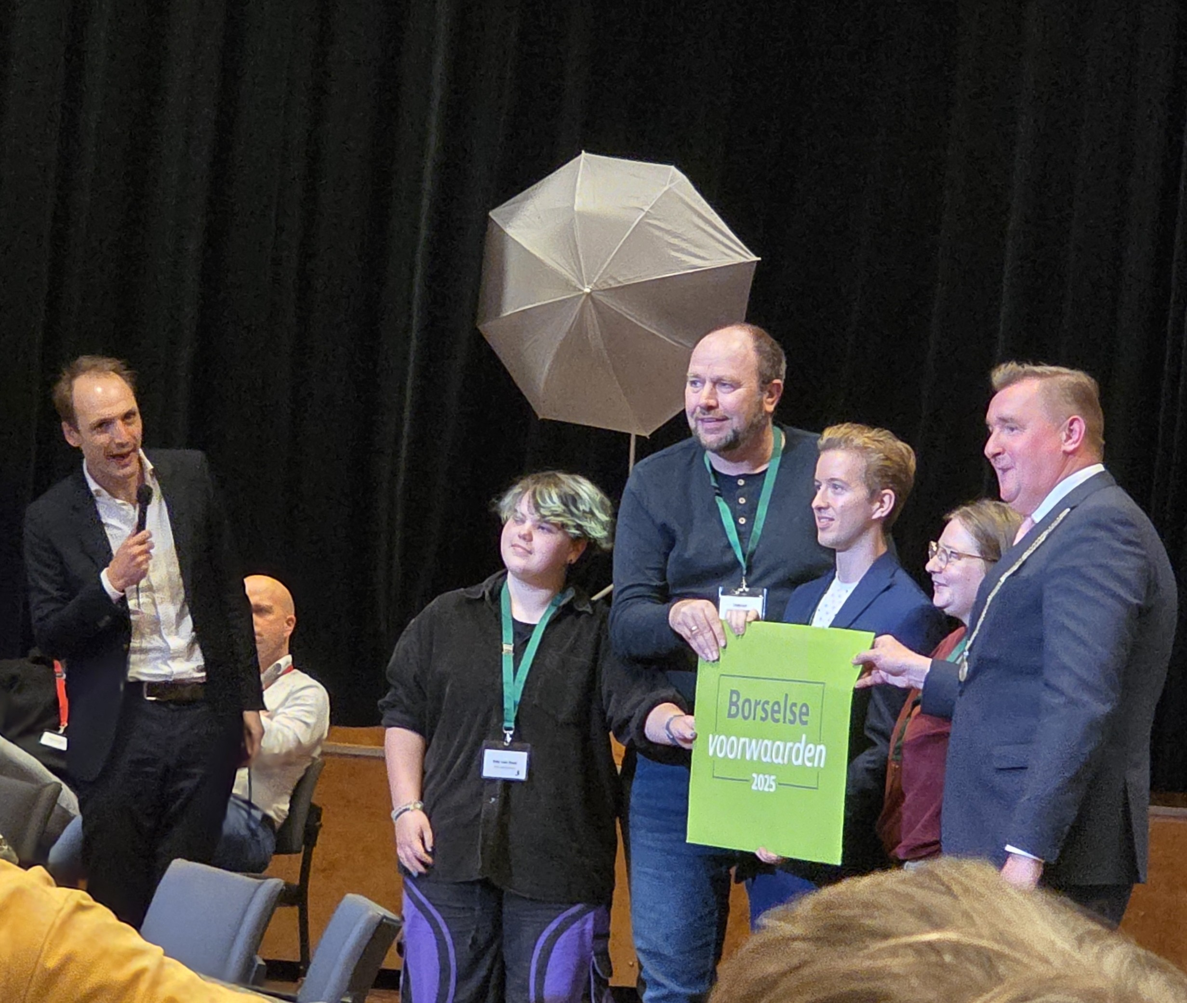
Work in 2025
Defined 39 conditions – included compensation.
Drew up a Local Impact Report and carried out a baseline measurement.
Establishing a Local Impact Fund.
Adjusting and tightening the Borselse Conditions – Group reconvened in 2025
Looking at new proposal for a gas fired power station.

Slide 9
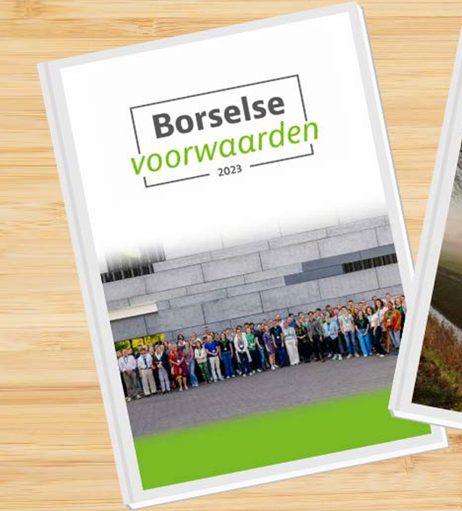
Conclusions
An innovative approach – connects with all demographics.
Empowers community and provides expert support where needed.
Enables energy projects to be considered in the round.
Scope for use in UK context:
    NDA study
    Identified in Nuleaf engagement report
    Climate change

Slide 10
More Information: www.borsele.nl/english
Philip Matthews
Executive Director
philipmatthews@nuleaf.org.uk
07949 209126
@nuleaforguk
www.nuleaf.org.uk

