Slide 1
Nuleaf Steering Group Meeting
NDA Strategy 5
Koulis Efkarpidis
Editor in Chief NDA Strategy
11/03/2026

Slide 2

NDA Strategy 5:
From Consultation to Publication
NDA Strategy 5 published Monday 23rd February 2026
Statutory five-year Strategy under the Energy Act 2004
Approved by:
  - NDA Board (December 2025)
  - DESNZ Secretary of State
  - Scottish Government Minister
Developed through extensive engagement and public consultation
Today’s session:
  - Briefly recap journey to publication
  - Summarise consultation feedback

Slide 3
Strategy 5: End-to-End Journey
Strategy 5 development timeline
March 2024 – Strategy review formally commenced
July–September 2025 – 12-week public consultation
Autumn 2025 – Thematic review of ~1,000 lines of feedback
Post-consultation – Clarificatory and narrative updates applied
December 2025 – NDA Board endorsement
January–February 2026 – Ministerial approvals and final checks
23 February 2026 – Strategy laid before Parliament and published
Strategy 5 represents a progression, not a reset;
maintaining strategic direction while strengthening clarity, integration and delivery realism.

Slide 4
Public Consultation: Scale and Reach
Consultation overview
12-week statutory consultation (7th July – 29th September 2025)
Nearly 100 formal responses
Around 1,000 lines of detailed comments
Respondents included: Regulators and statutory consultees, Local authorities and Site Stakeholder Groups, NGOs and academics, Supply chain organisations, Operating companies, employees and members of the public
Engagement activities included:
Virtual Strategy webinar and live Q&A
Briefings with: SSGs, Nuleaf, NGOs, Industry fora
Targeted digital communications campaign

Slide 5
Nuleaf consultation feedback – key themes
During the Strategy 5 consultation, Nuleaf provided detailed and constructive feedback on several areas.
Key themes included:
Importance of strong engagement with local authorities and communities
Need for clarity on long-term site plans and timelines
Support for sustainability and circular-economy principles
Importance of socio-economic value for nuclear host communities
Continued focus on safe stewardship and responsible land reuse
Overall, Nuleaf recognised the Strategy as more accessible and clearer than previous
iterations, while encouraging continued dialogue with local authorities as
Strategy 5 moves into delivery.

Slide 6
How We Handled Consultation Feedback
Our approach
Each strategic theme assigned a Strategic Authority to review feedback
Comments assessed for:
  Strategic relevance
  Materiality
  Permissible post-consultation change
Legal advice applied to ensure compliance
Responses organised by:
  General feedback
  Theme-specific feedback
  Consultation questions
Key principle
Proportionate review:
  Respond meaningfully to substantive feedback
  Avoid reopening agreed strategic direction

Slide 7
Overall Consultation Messages
What we heard
Strong support for:
NDA’s statutory mission and long-term responsibilities
Continued focus on risk and hazard reduction
Greater integration enabled by One NDA
Positive feedback on:
Strategy structure (Driving Themes + Critical Enablers)
Clarity and accessibility of the document
Recognition of:
Funding constraints
Need for realistic, risk-informed prioritisation
No change to overall strategic direction
What changed as a result
Targeted updates to:
  Clarify intent
  Strengthen narrative coherence
  Improve transparency

Slide 8
Transparency and Traceability
How we ensured openness
All comments recorded and reviewed
Outcomes captured in governance logs
Cross-theme comments handled collaboratively
Track-changes versions shared during governance review
Full Stakeholder Response Report published alongside Strategy
Consultation feedback has strengthened clarity and confidence in Strategy 5, without changing its strategic intent.

Slide 9
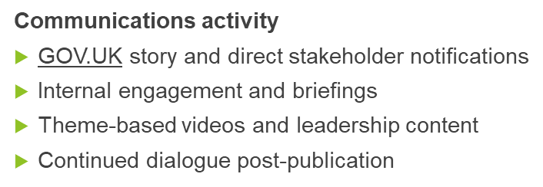
Keeping Strategy 5 “Live” Post-Publication
Beyond publication
Strategy embedded through:
  NDA Business Plan
  Mission Progress Report
  Site and topic strategies
Ongoing engagement with:
  Regulators
  Government
  Stakeholders

Slide 10
QUESTIONS

