Slide 1
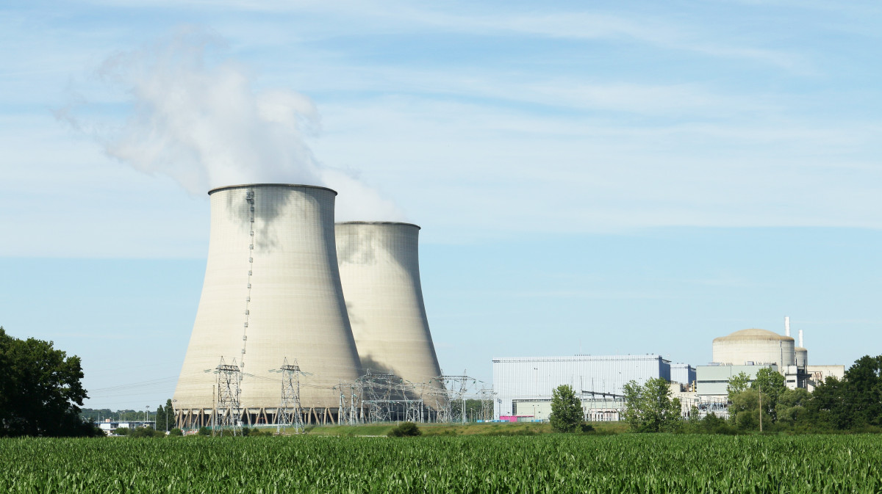
Nuclear Sites and Climate Change
Presentation for Nuclear Advisory Legacy Forum – Radioactive Waste Planning Group
Amartya Deb
9th September 2026.
Views expressed are personal. Photo: CC0 1.0 Universal
Notes:
https://pxhere.com/es/photo/1097297
Nuclear sites - both power generation and storage

Slide 2
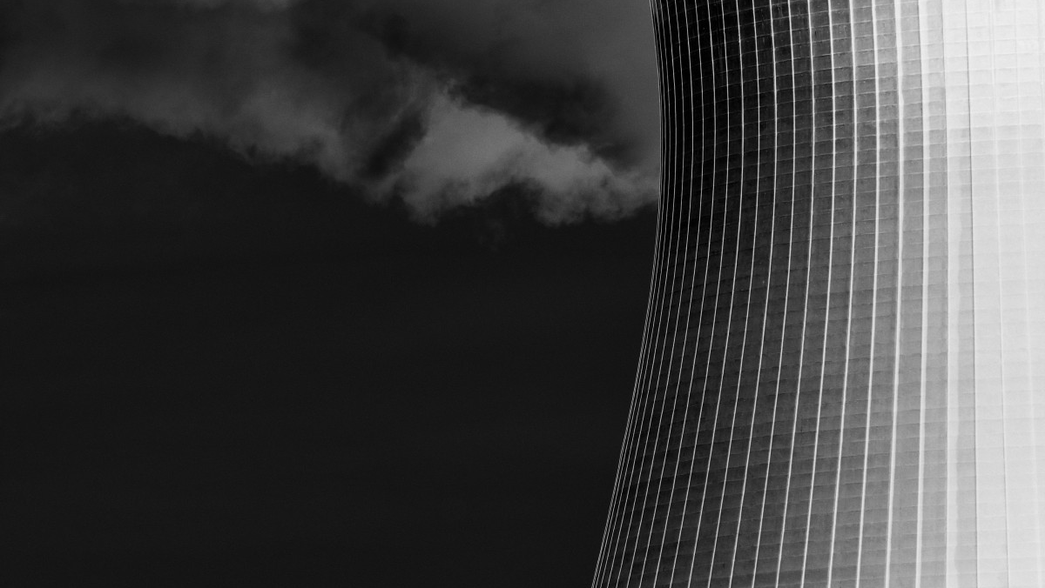
Changing Climate & Disruptions.
Notes:
CC0 Dominio publico
https://pxhere.com/es/photo/1383359

Slide 3
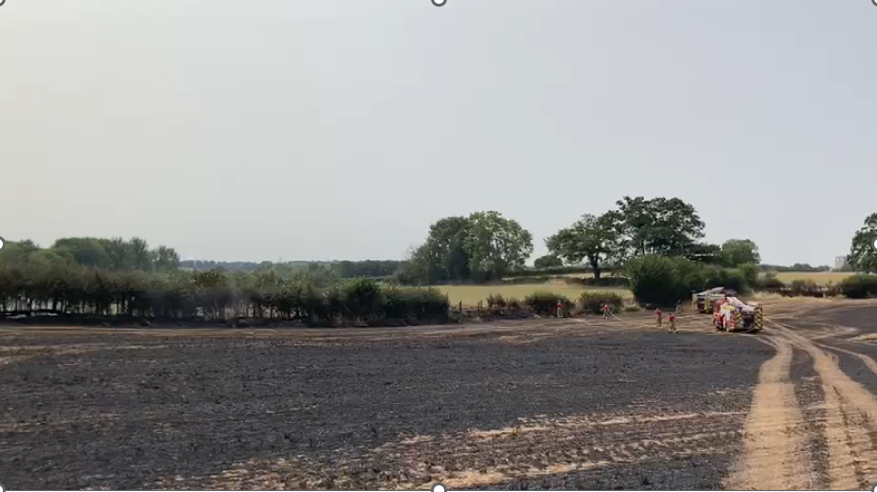
Recent wildfires Jul–Aug 2026
36 ha
Gloucestershire (near Berkeley Site)
150 ha
Suffolk (near Sizewell Sites)
“Wildfires can pose direct risk to nuclear site, or disrupt operations along routes transporting nuclear waste causing delays and diversions
Photo: Gloucestershire Fire and Rescue Service
Notes:
Wildfire on Suffolk coast near nuclear power station ‘stabilised’ | The Independent
Wildfire near Sizewell nuclear plant causes ‘total devastation’ to Suffolk landscape | Suffolk | The Guardian
Movement of nuclear canisters along railway line at Berkeley

Slide 4
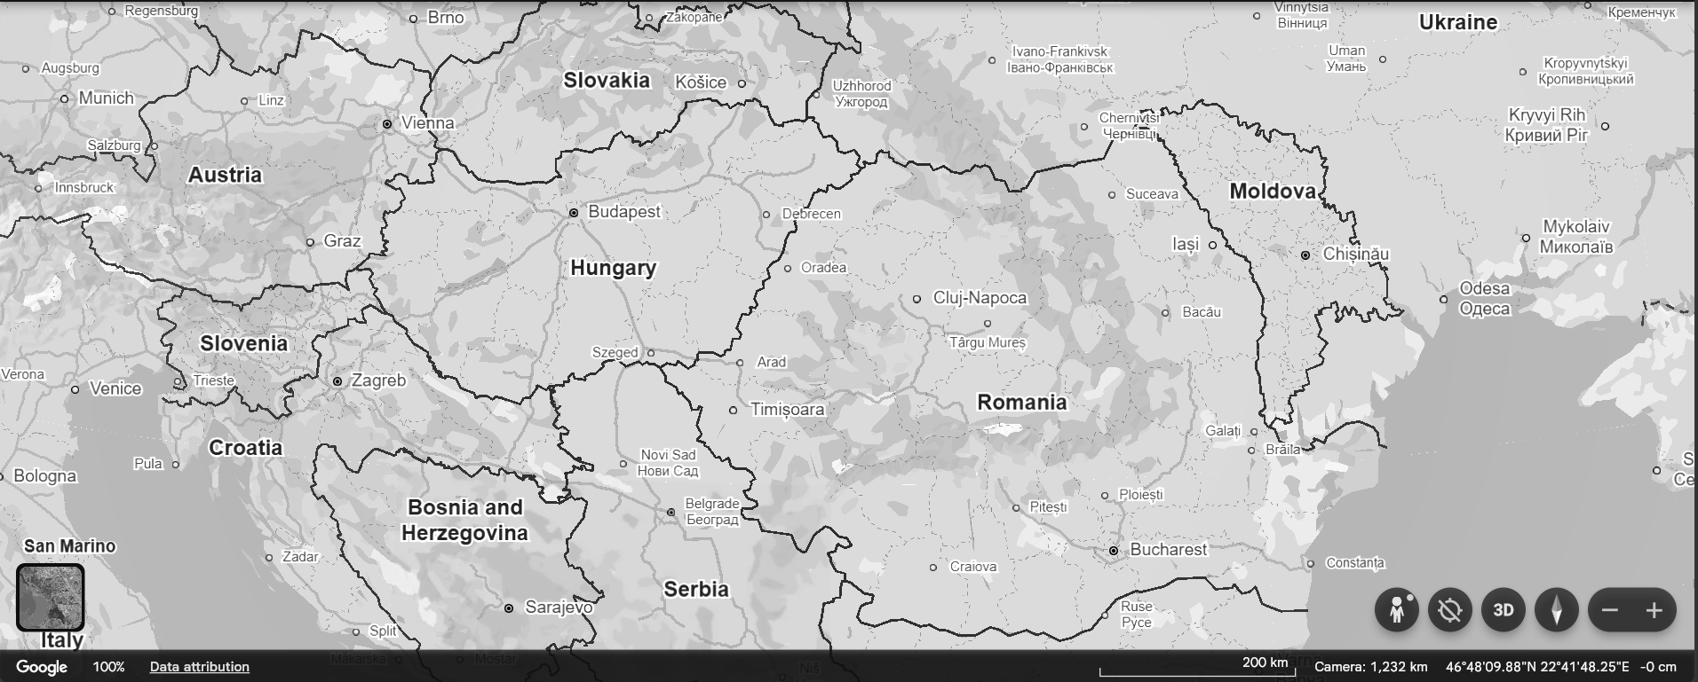
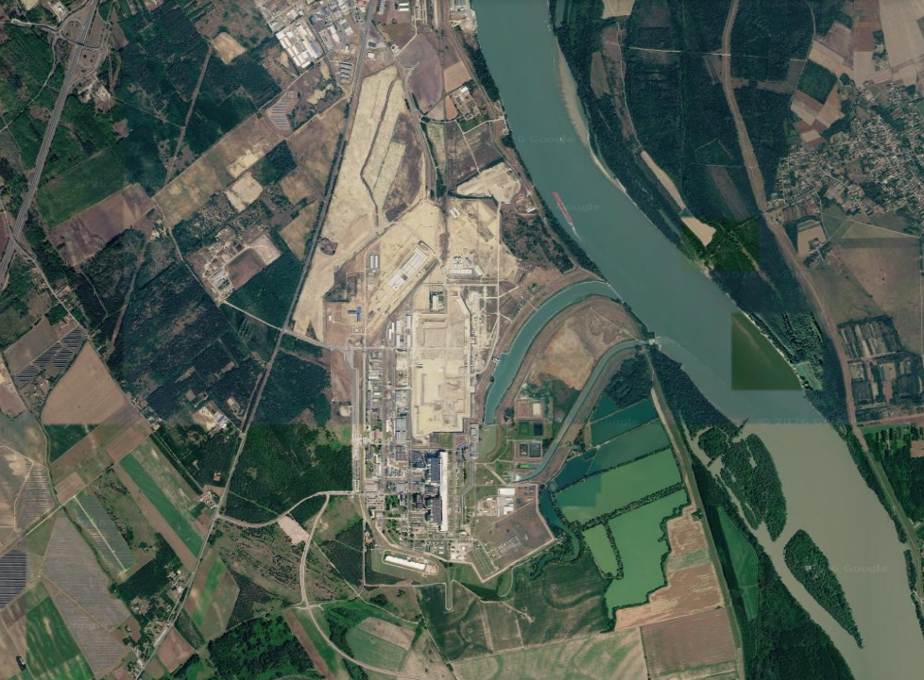
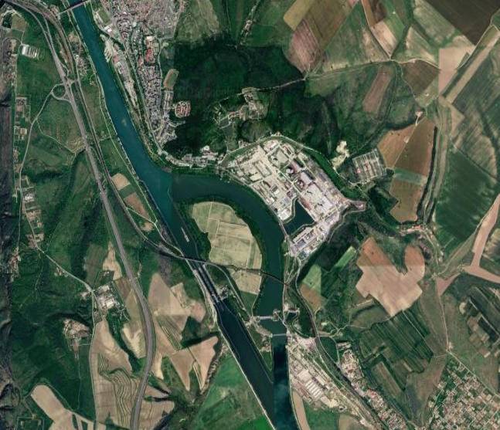
The Danube River drought, August 2026
Three nuclear plants affected across Bulgaria, Hungary and Romania
Crisis response
Rock blasting to divert water
Sinking barges to raise water levels
Reducing output
Shutting down nuclear plants
1
Water level Aug 2026
122 cm lower than normal
Budapest
1
Paks Nuclear Plant, Hungary
2
Average river flow Jul-Aug 2026
4,700 m3/s down to 1500 m3/s
Black Sea
2
The Danube
Bucharest
Kozloduy Nuclear Power Plant, Bulgaria
Cernavodă Nuclear Power Plant, Romania
Sources: The Week | The Guardian | BBC |Reuters . Satellite Imageries: Google Earth (2021 & 2023) 1:1000m.
Notes:
Localised vs Regional risks

Slide 5
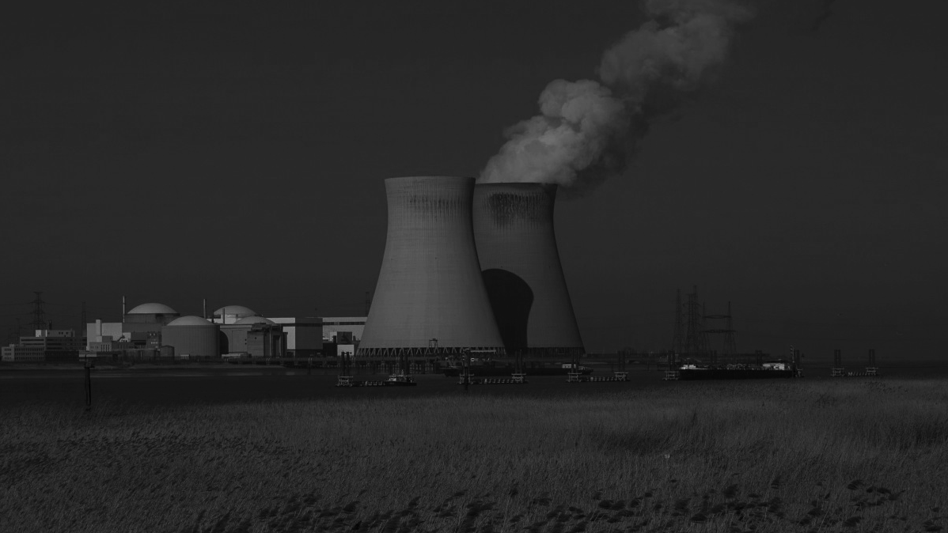
Risks from water environment
GLOBAL
23 nuclear power plant sites worldwide could be affected by Tsunamis
50 TWh
2010-19: Power loss globally due to increase in outrages, mainly due to warming of cooling water.
UK
12 of 19 nuclear power plant sites in UK at risk from flooding & coastal erosion*
SMRs
2025: New nuclear power plant development in Oldbury is faced with high level of flood risks
Sources: New Civil Engineer 2025 | No2NuclearPower 2025 | *The Guardian 2012 | Portugal-Pereira et al., 2024.
Notes:
Most of the data is recent – i.e. 2019-2024-2025 except for the 12 of 19 flood risk *Guardian 2012

Slide 6
Extreme Climate: What to expect
Notes:
CC0 Dominio publico
https://pxhere.com/es/photo/1383359

Slide 7
Short-term and long-term risks: Radioactive Waste (RW)
Short-term: Operational powerplant – disruption, destruction
Long-term Waste storage – contamination risks due to weather
E.g., Geological disposal facility – site selection – end state
Operational life of a nuclear plant (c. 40-80 years)
Decommissioning time span (c. 30-60 years)
T = 0 Y 500 Y 1000 Y 2000 Y 5000 Y 7500 Y 10 KY
GDF
Active
Passive (hundreds of thousands of years)
Short-term - construction and operational
e.g.,
Storm surges leading to floods
High temperature increases wildfire risk
Long-term - post-closure. Integrity of RW in repositories
e.g.,
Global warming and global cooling
Geomorphological evolution of the region
Notes:
Notes: Peti et al., 2026. Impact of Climate Change on Nuclear Waste Management.

Slide 8
Cross-sectoral
Challenges & Risk Arenas
Notes:
CC0 Dominio publico
https://pxhere.com/es/photo/1383359

Slide 9
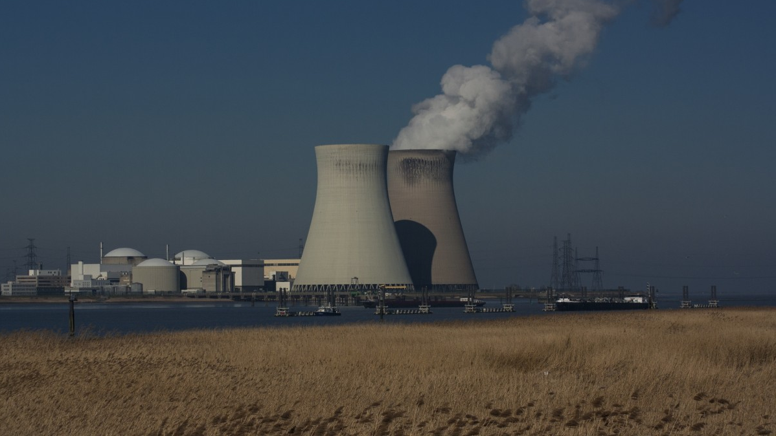
“Nuclear infrastructures are not isolated systems.
i.e., they are interconnected with
Transportation networks
Energy transmission grids
Natural ecosystems, etc.
50 TWh*
2010-19: Power loss globally due to increase in outrages, mainly due to warming of cooling water. Can power millions of homes for a year.
*Sergio & Colelli, 2025.
“Climate change can affect any of the sub-systems and lead to operational disruptions
Notes:
https://pxhere.com/es/photo/797829 CC0 Dominio publico
Copilot - 50 TWh can power ~13.9 million UK homes for one year.
Notes: Sergio & Colelli, 2025. 10.1016/j.eneco.2025.108549

Slide 10
Risk arenas that improves understanding of the interconnectedness
Transportation
Risk: Disruption
Risk: Disruption
Risk: Disruption
Human Settlements
Nuclear Plant
Off-site Waste
Management
Risk: Disruption
Water
Environment
Risk:
Contamination
Risk:
Contamination
Notes:
Common goals to help us move beyond a sectoral dialogue

Slide 11
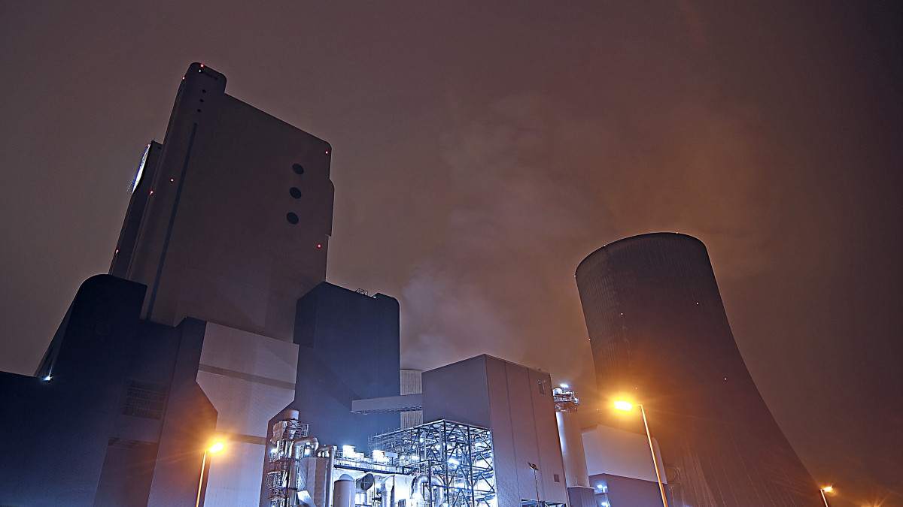
Enabling cross-cutting dialogues
Nuclear sites have dependencies beyond their local settings
Climate change has long-term and short-term impacts on nuclear sites
Addressing sector-specific impacts are necessary but not sufficient
Agenda setting – risk arenas for future discussions
Notes:
CC0 Dominio publico Link - https://pxhere.com/es/photo/779703

Slide 12
Thank You.
Notes:
CC0 Dominio publico
https://pxhere.com/es/photo/1383359

