Slide 1
Update from ONR – nuclear legacy focus
Shane Turner Director of Regulation – Sellafield, Decommissioning, Fuel, Waste and Transport

Slide 2
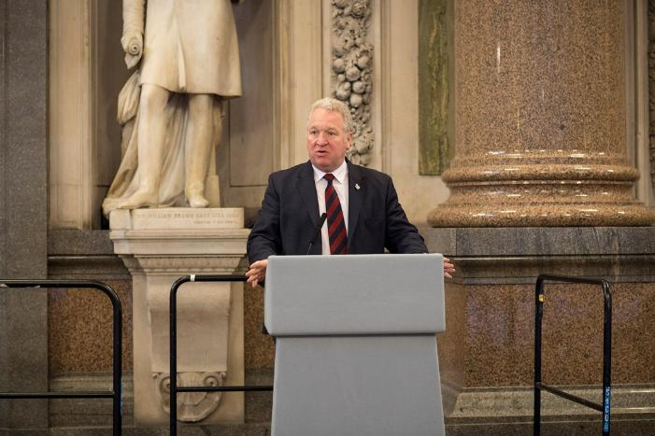
ONR – our legal basis
ONR was established as a statutory Public Corporation on 1 April 2014 under the Energy Act 2013
The Act provides the framework of responsibilities and the powers of the organisation
ONR is formally established by Part 3 of the Energy Act, and a Commencement Order brought the relevant sections and the organisation into being
The Rt Hon Mike Penning MP on 1 April 2014, at St Georges Hall, Liverpool - copyright ONR

Slide 3
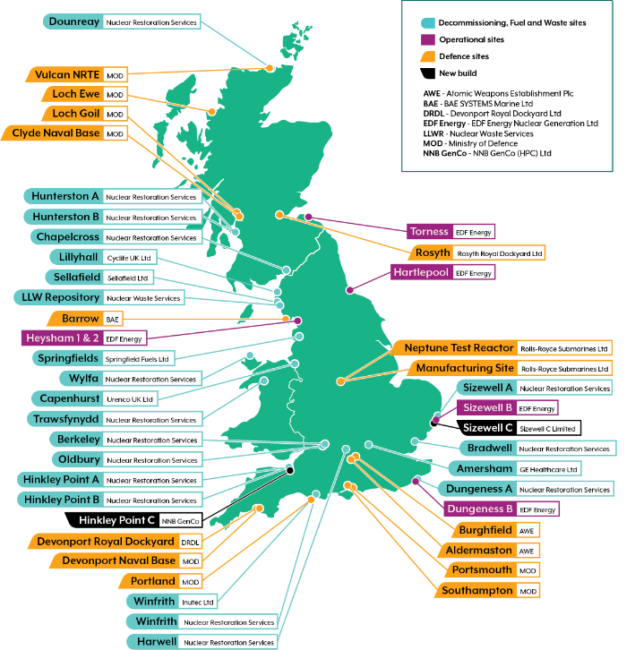
What we regulate
We are the UK’s independent nuclear regulator for safety, security and safeguards
We have the legal authority to regulate nuclear safety, nuclear security and conventional health and safety at all licensed nuclear sites in Great Britain (GB)
We also regulate the safety of transport of nuclear and radioactive materials

Slide 4
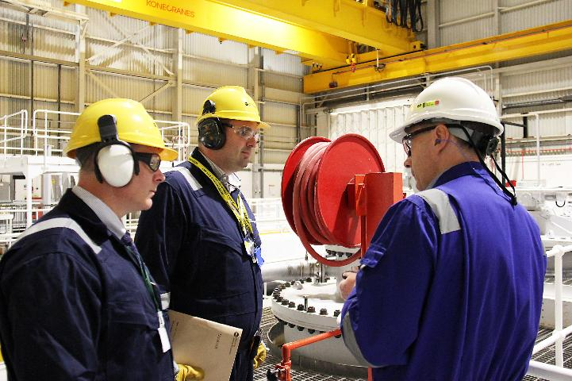
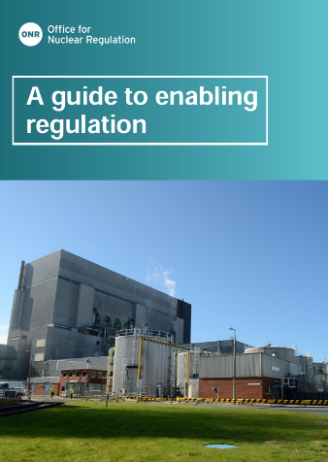
Our regulatory approach – Enabling Regulation
“We will take a constructive approach with industry ‘dutyholders’ and other relevant stakeholders to seek effective delivery against clear and prioritised safety and security outcomes.
“We are clear with licensees and dutyholders that our independence in regulatory decision making is not compromised and we continue to hold them to account in accordance with our mission.”
Images copyright of ONR.

Slide 5
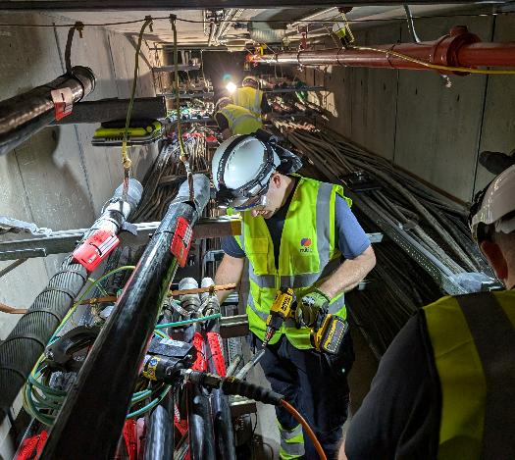
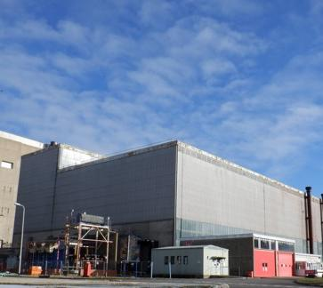
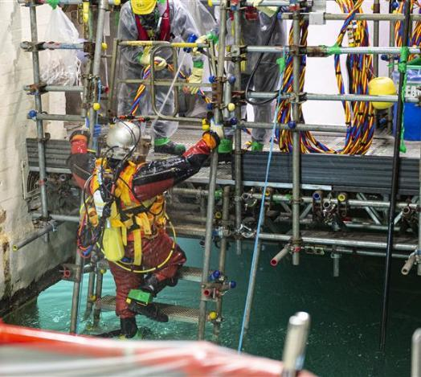
Enabling regulation in action
Oldbury cable cutting
Completed during two weekends as opposed to 12 months
Sizewell A turbine hall demolition
Allowed explosive demolition of the turbine bases
Pile Fuel Cladding Silo
Use of divers to access the pond
Cutting of cables entering turbine hall at Oldbury – Image courtesy of Nuclear Restoration Services
Sizewell A Turbine Hall – Image courtesy of Nuclear Restoration Services
Divers in Pile Fuel Cladding Silo – Image courtesy of Sellafield Limited

Slide 6
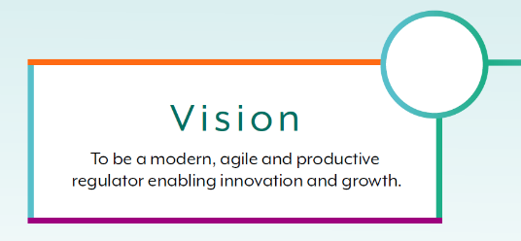
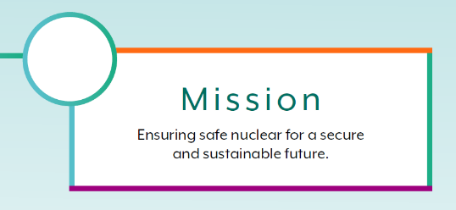
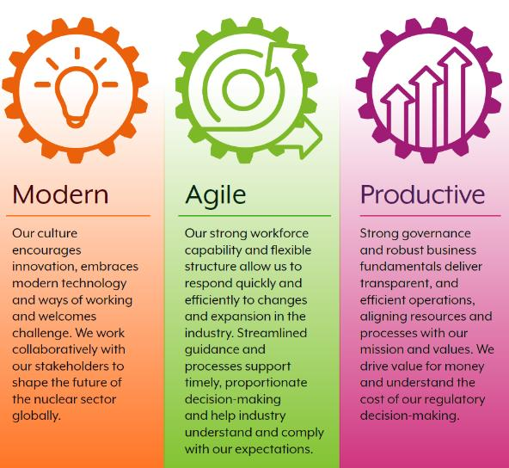



ONR strategy – ONR Together

Slide 7
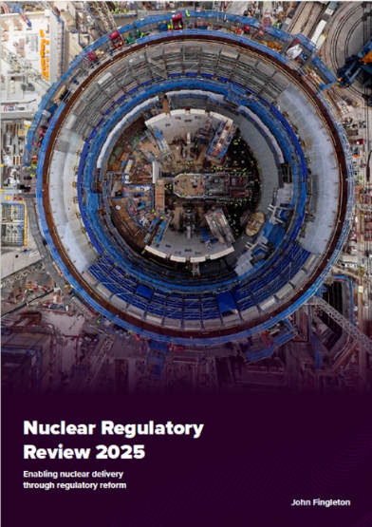
Nuclear Regulatory Taskforce
ONR actively supporting implementation of recommendations
Engaging constructively with government, regulators and industry
Positive progress on many ONR-led recommendations
Response to the Chancellor’s Letter published on our website
Our role is to regulate the nuclear industry so that it remains safe
ONR agrees with the Taskforce’s explicit view that safety must not be undermined - the goal is to maintain, and in some cases, enhance standards, while removing complexity and bureaucracy

Slide 8
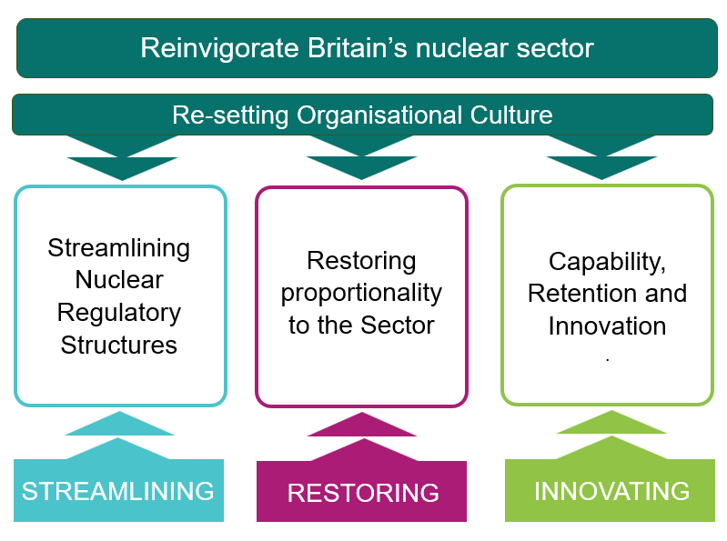
Building Our Nuclear Nation

Slide 9
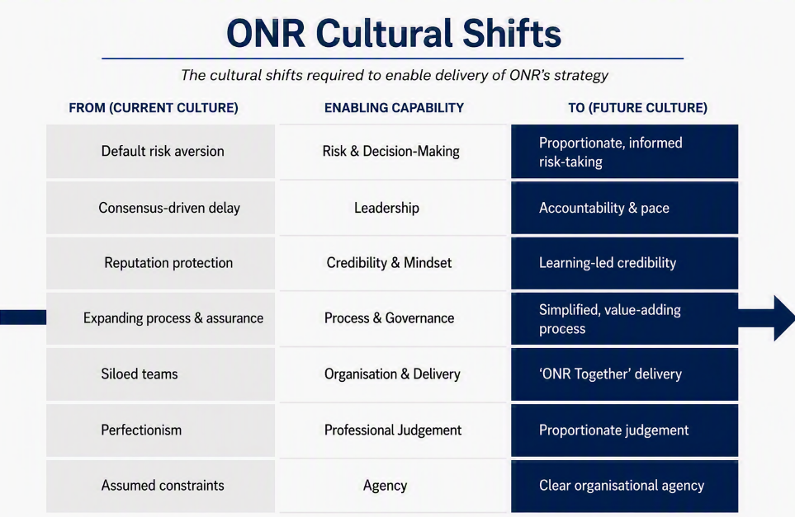
Response to Chancellor’s Letter
ONR Cultural Shifts
The cultural shifts required to enable delivery of ONR’s strategy
Our response focuses on four priorities:
Creating a more integrated nuclear regulatory system
Stronger leadership and accountability
More proportionate and targeted approach to risk
Cultural transformation
ONR's fundamental purpose remains: to protect people and society

Slide 10
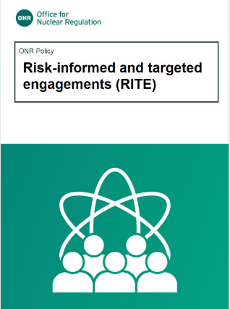
Decommissioning strategic objective
Enable safe and secure timely decommissioning
Key question:
Are we focusing our regulatory effort where it will have the greatest impact on risk reduction and decommissioning progress?
How do we regulate an operating nuclear facility?
How do we regulate safe dismantling and removal of the remaining hazards at pace?

Slide 11
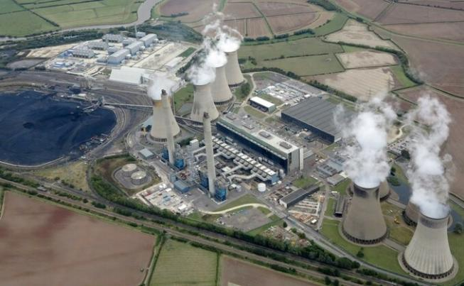
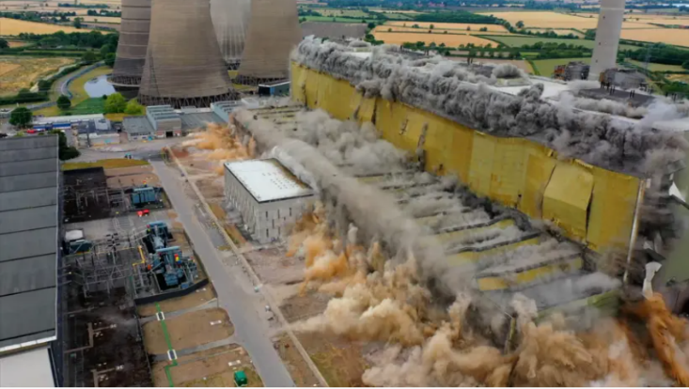
Conventional decommissioning – West Burton A
Operating station – 2023
2025
Brownfield site ~2028

Slide 12
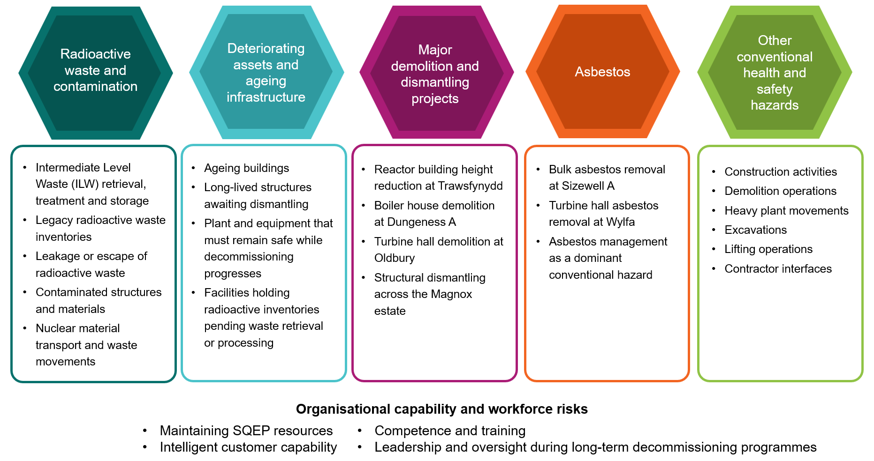
Typical safety hazards – decommissioning sites

Slide 13
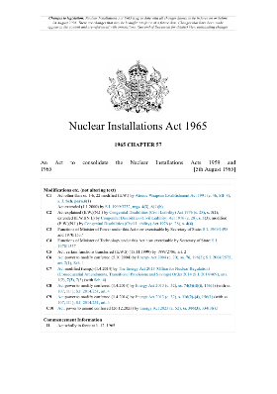
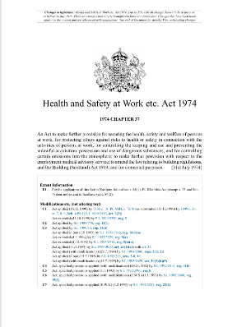
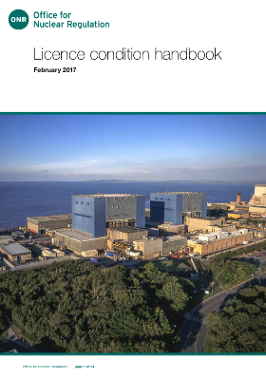
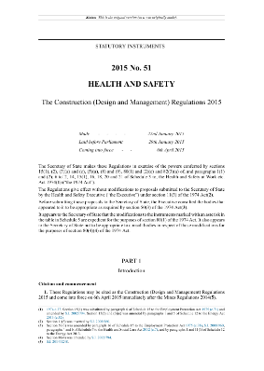
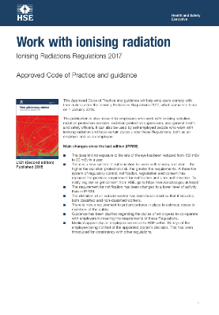
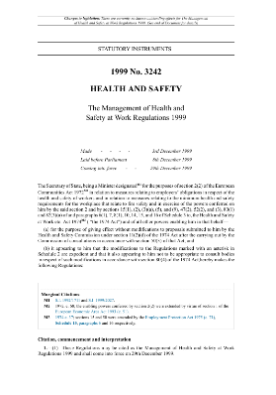
Legislative toolkits
Nuclear safety and
radioactive waste
Health and safety
etc.
etc.

Slide 14
RITE proportionate regulation: targeting attention where it adds most value
Purpose
A risk-informed, intelligence-led operating model that focuses ONR effort on the most significant risks and decommissioning outcomes
1
2
3
4
5
Priority licence conditions
Key Decommissioning Milestones (KDMs)
Conventional safety and CDM
Independent Oversight
Themed inspections
Focus routine attention where it is most relevant, while retaining discretion to inspect any LC
Hold NRS to account for timely, measurable risk reduction and decommissioning delivery
Use CDM regulation for suitable major projects instead of unnecessary nuclear permissioning
Use NRS assurance intelligence where justified without transferring ONR’s statutory role
Use cross-cutting, risk-based themes informed by fleet and site intelligence
Not deregulation: all licence conditions remain applicable and ONR retains regulatory independence and discretion to increase attention

Slide 15
Key Decommissioning Milestones (KDM)
What KDMs are intended to do
Basis for NRS prioritisation
ONR position
Provide quantifiable nuclear and conventional safety risk reduction
Focus on risks that are highest or least well controlled
Support accountability for timely decommissioning delivery
Reducing risk and hazard
Sustainable outcomes
Nine proposed KDMs are broadly appropriate and represented step changes in risk reduction
KPMs and KPIs being developed
Asset condition
Asbestos
Environmental risks
Radiological waste
Lifetime cost
Environmental value
Socio-economic dependence
Enabling the mission
Nine NRS proposed Key Decommissioning Milestones
Trawsfynydd
Reactor building height reduction
Dungeness A
Boiler house removal
Sizewell A
Bulk asbestos removal
Reflections
Key Performance Measures (KPMs) and Key Performance Indicators (KPIs) need to be sufficient to give early warning of slippage
Milestone dates need to be baselined and linked to credible delivery plans
Oldbury
Turbine hall demolition
Wylfa
Turbine hall asbestos removal
Chapelcross
Operational / legacy ILW treatment
Berkeley
Operational / legacy ILW treatment
Harwell
Nuclear material transport
Hinkley Point A
Wet ILW treatment

Slide 16
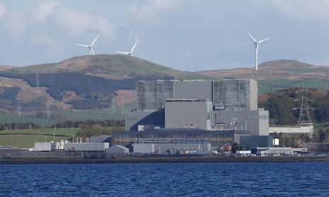
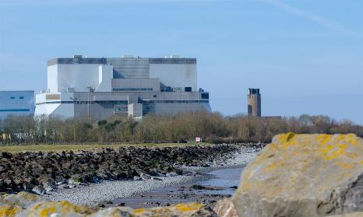
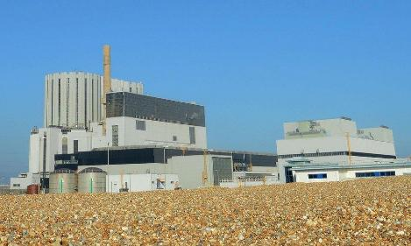
AGR transition and transfer – review, learn and improve
HNB
“Prove”
Demonstrated relicensing model works
Established assessment framework
Identified key transfer risks
HPB
“Improve”
Applied learning from HNB
Focus on change
Reduced reassessment effort
Increased focus on implementation readiness
Future AGR Transfers “Repeat”
Reuse established assessment outcomes
Focus on changes and implementation
Earlier readiness assurance
More proportionate regulation
Regulatory focus shifting from assessing arrangements to verifying readiness to implement them

Slide 17
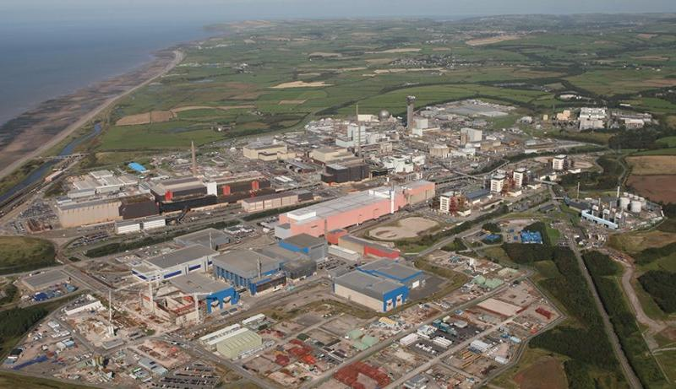
Sellafield
Strategic outcomes
Reduce legacy hazard​
Sustained control of risk​
Build mission capability​
Sustainable future site​

Slide 18
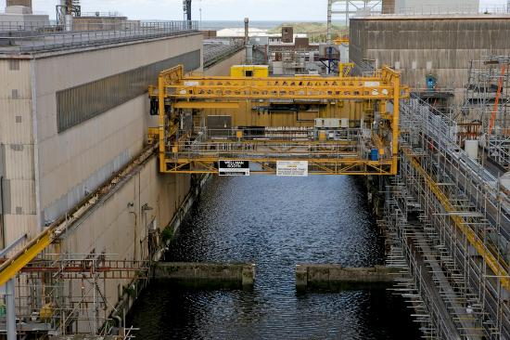
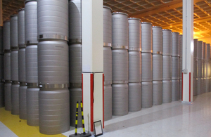
Sellafield regulatory priorities (1)
Apply proportionate regulation that provides assurance to all stakeholders
Influence improvements to the site’s security which recognises the current and future nuclear inventory and activities
Regulate safe, secure, and consistent retrieval of waste and fuel from legacy silos and First Generation Magnox Storage Pond (FGMSP)
Regulate safe and secure storage of Special Nuclear Material (SNM) and delivery of new facilities to safely and securely house and account for SNM prior to immobilisation
Use regulatory insight to influence the management of single point vulnerabilities which have the potential to significantly and adversely impact security improvements, high hazard risk reduction (HHRR), the management of SNM and AGR Operation Programme (AGROP)
Images courtesy of Sellafield Ltd

Slide 19
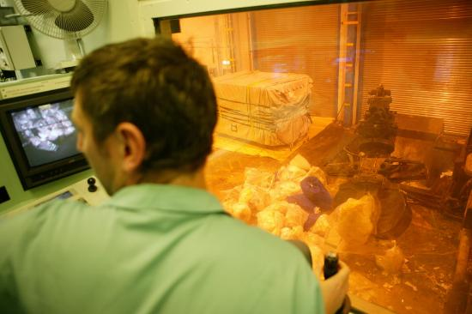
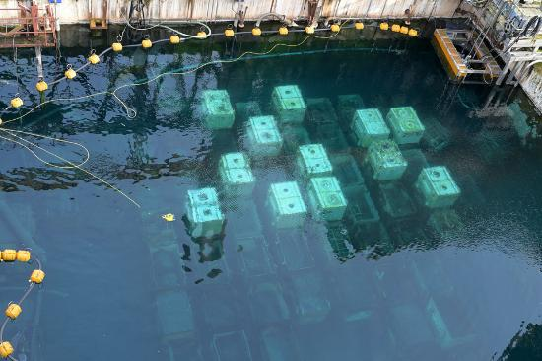
Sellafield regulatory priorities (2)
Deliver targeted safeguards regulation, reporting and coordination with IAEA
Regulate arrangements for emergency preparedness and response ensuring clear lines of sight of accountability, responsibility and ownership
Promote and influence the importance of disciplined operations, robust safe systems of work and security mindset on site to protect the health and safety of the public and workers
Demonstrate modern regulation through commitment to innovation and collaborative working as part of the G6, respectfully challenging ourselves and others in the pursuit of accelerating risk reduction on the Sellafield site.
Provide confidence that Sellafield Limited has the organisational construct, governance, assurance, management system and capability to deliver its undertakings
Images courtesy of Sellafield Ltd

Slide 20
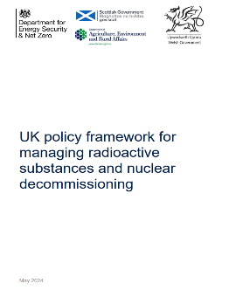
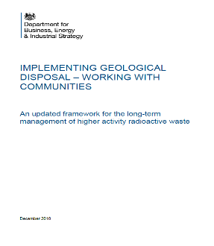
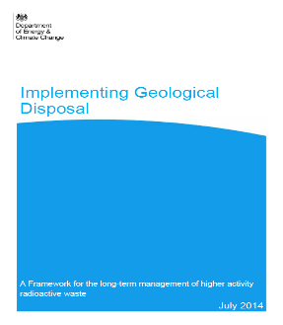
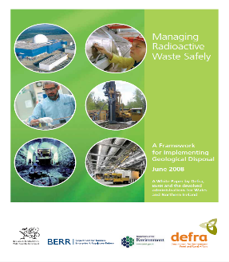
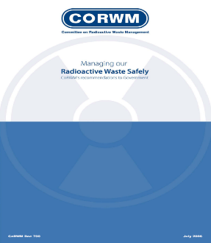
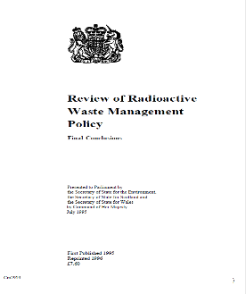
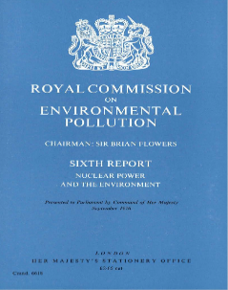
GDF – UK policy
2024
Government policy (England and Wales) for geological disposal of Higher Activity Waste (HAW)
  Siting based on a voluntarist approach
  A GDF should be a licensed nuclear installation
  2024 policy supports development of near-surface disposal for some Intermediate Level Waste (ILW)
Scottish government policy is near-site, near-surface management of HAW
2019
2014
2008
2006
1995
1976

Slide 21
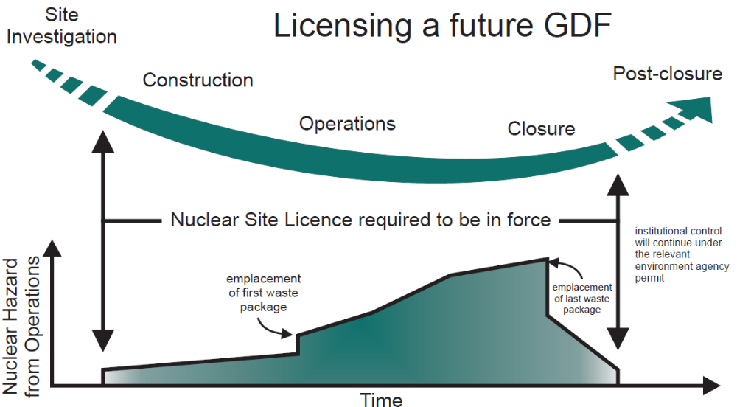
GDF – nuclear licensing
Nuclear site licence needed before “nuclear safety related construction” because if inadequately conceived or executed could have safety implications
ONR will jointly regulate GDF with EA during operations as for any other nuclear licensed site
GDF can be delicensed when it is closed and sealed (and meets post-closure safety case) and surface facilities decommissioned
GDF will have an environmental permit

Slide 22
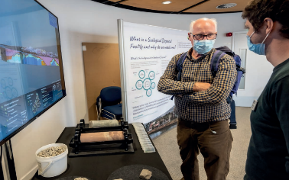
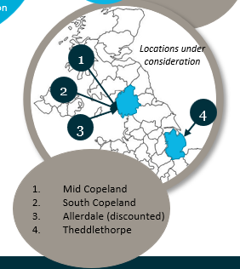
GDF – siting process
GDF siting process follows a voluntarist-based approach to siting with financial incentives to communities who volunteer to participate and a ‘Test of Public Support’
Currently there are two areas involved in the process, both in Cumbria, near Sellafield (mid and south Copeland)
Both areas involve an ‘inshore’ region (under territorial waters) with access from land but disposal galleries/vaults under the seabed)
Nuclear Waste Services (NWS), the developer of the GDF, made a recommendation to UK Government on the next steps last year based on the results of this current phase of work

